Slide 1

Monitoring & EVALUATION
experiential
Training

Slide 2
Introduction to THE training
MODULE 1

Slide 3
AGENDA
I. Introductions and training organization
II. MEAL's interest for ACTEI
III Introduction to MEAL
IV. Issues surrounding MEAL
V. The project cycle and MEAL
Notes:
Check session 3 - dashboard presentation - to be updated

Slide 4
presentations

Slide 5

YOUR FACILITATORS
This training session will be led by :
Karthikeyan T
Nithin Kumar N
This course was designed by :
Valerie
Pilar
Geoffrey
Training - experimentation, based on your tools and realities in the field.
Your feedback will be used to fine-tune the processes, tools and challenges of the new monitoring-evaluation system.
Notes:
Exchange with participants to check ownership of dashboard objectives - 5 minutes

Slide 6


WHO TAKES PART?
Introduce yourself by answering the following questions:
Who are you?
Which position you hold? And what are your broad responsibilities?
What significant experience(s) do you have in Monitoring & Evaluation?
Quickly present your project and your specific expectations for the training.
We have 10 minutes for this exchange.
Notes:
Exchange with participants to check ownership of dashboard objectives - 5 minutes

Slide 7
TRAINING ORGANIZATION

Slide 8

WHY THIS COURSE?
List 5 reasons why this training is important for you, for your teams, for your partners, for the organization?
You have 10 minutes to exchange.
Notes:
Exchange with participants to check ownership of dashboard objectives - 5 minutes

Slide 9
TRAINING Objectives
This training aims to:
Share a common vision of Monitoring and Evaluation (M&E) at ACTEI ;
Ensure basic knowledge of monitoring and evaluation for ACTEI's operational teams
Strengthen the skills and capacities of ACTEI teams to implement a Monitoring & Evaluation system.
Contribute to the adoption of harmonized and common M&E tools at ACTEI
Gradually support the deployment of M&E
Notes:
Exchange with participants to check ownership of dashboard objectives - 5 minutes

Slide 10
HOW IS THIS TRAINING ORGANIZED?
Format:
Mixed training: asynchronous work (at your own pace), synchronous work, live sessions with your trainers.
Training equivalent to 4D of training: 6 synchronous sessions (3h), 5 asynchronous sessions (individual work) (2h).
WEEK 1
WEEK 2
WEEK 3
12h
12h
12h
To meet
Placement test
Pre-reading/ ACTEI policy
Submitting work at every stage
Contents
Retex
Community of practice
Individual action plan
End of course quiz
Satisfaction questionnaire
Notes:
Exchange with participants to check ownership of dashboard objectives - 5 minutes

Slide 11
Course
Legend
 | Synchronous working - live sessions
 | Asynchronous learning - to be submitted on moodle
Week 1: REMOTE
 |  | Monday | Tuesday | Wednesday | Thursday | Friday
Morning |  | 9:30am -12:30pm Synchronous working Part 1 Introduction | Asynchronous work (+/- 1h of work) Part 1 The inventory of fixtures will be part of my project. |  | 9:30 -12:30 Synchronous work Part 2 Preparation phase | Asynchronous working (2 hours of work) Prepare the M&E plan.
Week 2: DISTANCIEL
 |  | Monday | Tuesday | Wednesday | Thursday | Friday
Morning |  | 9:30-12:30 Synchronous work Part 3 Implementation phase Project launch | Asynchronous work (2 hours) Setting up the Dashboard |  | 9:30-12:30 Synchronous work Part 4 Implementation phase - data collection
Week 3: DISTANCIEL
 |  | Monday | Tuesday | Wednesday | Thursday | Friday
Morning |  | 9:30 a.m.-12:00 p.m. Synchronous working Part 5 Implementation phase - Analysis | Asynchronous work (1h of work) Using the dashboard - Analysis |  | 9:30 - 12:00 Synchronous work Part 6 Transition and Closing phase | Asynchronous work (1h of work) End of training - test
Notes:
Exchange with participants to check ownership of dashboard objectives - 5 minutes

Slide 12
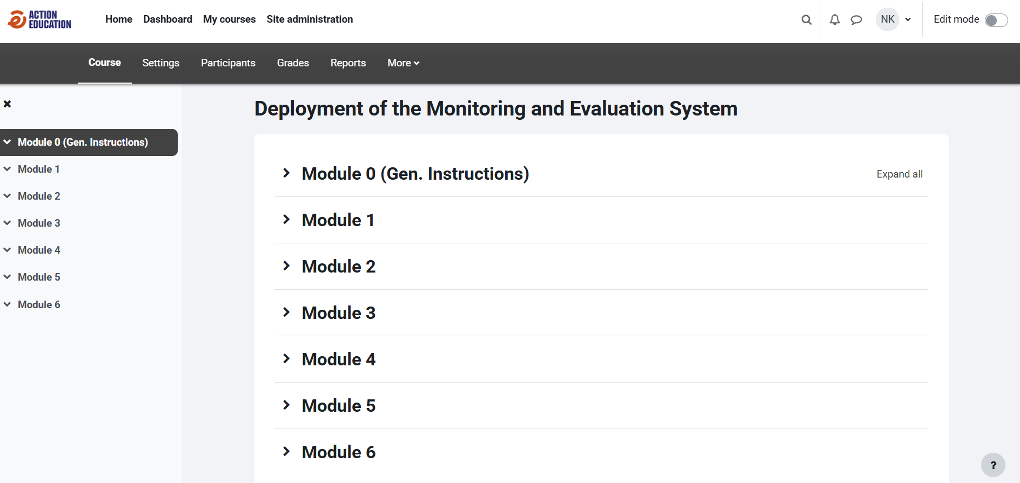
Ways & Means of enagagement
Start date :
Positioning yourself in relation to pedagogical objectives
During training :
Trainings in Zoom Platform
Submit individual work (Google Drive & Moddle)
Take an active part in the chat, ask questions and launch debates.
At the end of the course :
Positioning yourself in relation to pedagogical objectives
Knowledge test
Satisfaction assessment
Notes:
Exchange with participants to check ownership of dashboard objectives - 5 minutes

Slide 13
PEDAGOGICAL objectives
At the end of the course, participants should be able to :
Share a common vision of Monitoring & Evaluation at ACTEI.
Apply basic knowledge of the monitoring-evaluation system, in line with the ACTEI monitoring-evaluation policy;
Integrating M&E into a project cycle management approach ;
Design and implement key M&E tools - Indicators, M&E Plan, data collection and analysis tools, evaluation, etc. ;
Gradually support the deployment of M&E
Notes:
Exchange with participants to check ownership of dashboard objectives - 5 minutes

Slide 14
Session 1
INTRODUCTION TO MEAL

Slide 15
PEDAGOGICAL OBJECTIVES - session 1
At the end of this module, participants should be able to :
Identify the benefits of a MEAL policy for project teams and international management
List the components of a MEAL system and their definitions.
Understand the main concepts and issues surrounding MEAL
Identify M&E processes, milestones and tools for project management.
Notes:
Exchange with participants to check ownership of dashboard objectives - 5 minutes

Slide 16
INTEREST OF MEAL FOR ACTEI

Slide 17
WHY A MEAL POLICY?
GROUP
As a group, identify why it is necessary to have a MEAL policy specific to your organization - objectives?
You have 10 minutes to exchange.
Notes:
Exchange with participants to check ownership of dashboard objectives - 5 minutes

Slide 18

WHY A MEAL POLICY?
As part of our operational management, we are committed to transparent decision-making and accountability to the people we serve, as well as to our partners and donors of all kinds.
Harmonize our practices and capitalize on our know-how, to maximize the impact of our educational interventions.
Drawing on the lessons learned from our operations and the standards of the international solidarity sector, to guarantee the quality, effectiveness and impact of our actions.
Formalize the organization's commitments to anchor the MEAL culture within the organization's teams and stakeholders.
This policy affirms the mandatory nature of Action Education's Monitoring & Evaluation system. This system is mandatory for all projects, and replaces processes and tools that may have been developed by regions and/or countries.

Slide 19
WHY A MEAL POLICY?
In short, the policy aims to :
Provide an organization-wide MEAL reference framework
Display strategic orientations, guiding principles and key references for ACTEI
Define the MEAL institutional framework by presenting the minimum MEAL requirements for all ACTEI projects.
Develop and strengthen the MEAL culture and the use of information and knowledge for evidence-based decision-making at all levels.
Promote continuous learning and innovation based on the analysis of our operational practices and results.
Strengthen commitment to MEAL functions at all levels of the organization

Slide 20
WHAT EXPECTATIONS?
FOR OPERATIONAL TEAMS
FOR INTERNATIONAL DIRECTIONS
Notes:
Exchange with participants to check ownership of dashboard objectives - 5 minutes

Slide 21
INTRODUCTION TO MEAL

Slide 22

MEAL - DEFINITIONS
Monitoring
Evaluation
Accountability
Learning
Notes:
SOURCE : MEAL D PRO

Slide 23
MEAL - DEFINITIONS
GROUP 1
GROUP 2
In a group,
1. Find the definition :
MONITORING and LEARNING
2. List Who - Why - When (in the project cycle)
In a group,
1. Find the definition :
EVALUATION AND ACCOUNTABILITY
2. List Who - Why - When (in the project cycle)
You have 10 minutes to exchange.

Slide 24

MEAL - DEFINITIONS
Action Education defines evaluation as an in-depth examination of a project/program or policy, covering its design, implementation, outcomes and impact, in order to determine the effectiveness and sustainability of interventions. Evaluation involves the analysis of qualitative and quantitative data, and incorporates feedback from key stakeholders.
Monitoring
Evaluation
Action Education defines monitoring as a regular and continuous process of collecting and analyzing data on project/program activities and results. This includes feedback from stakeholders, in order to provide relevant information on the state of progress, progress in achieving results, and the quality of technical approaches and partnership relations. Monitoring also makes it possible to measure the state of budget consumption and the proper use of earmarked and non-earmarked funding.

Slide 25

MEAL - DEFINITIONS
Action Education defines accountability as the responsibility to ensure that work is carried out in accordance with agreed rules and standards, and to report clearly and accurately on progress, performance and results against the initial defined framework. It is also the responsibility to ensure that interventions are carried out in an ethical, transparent and participatory manner, with the involvement of communities and other stakeholders.
Action Education is committed to being accountable to its target groups, partners, government authorities, donors and the general public. MEAL's systems must, as a minimum, include a feedback mechanism to collect the opinions of supported populations, partners and relevant stakeholders on our interventions, as well as an information system on the results of our programs to enable adaptation and continuous improvement.
Learning
Accountability
Action Education defines learning as a continuous process of critical reflection, adaptation and improvement of knowledge, attitudes, skills and practices, based on data collected as part of monitoring and evaluation, as well as the experience and knowledge of those involved. Learning aims to improve the design, implementation and results of projects/programs on the basis of feedback and evidence.

Slide 26
MEAL - DEFINITIONS
MONITORING | EVALUATION |  | ACCOUNTABILITY | LEARNING
When?
Continuous / permanent during the project |  | Periodic (ex-ante, intermediate, final) | Continuous / permanent during the project | Periodic (start of project/ implementation/ end of project)
By whom?
Internally, by those responsible for project implementation | Internal or external or mixed | Internally, by those responsible for project implementation | Internal or external or mixed
Why?
Steering the project, assessing progress, informing decision-making, taking corrective action, updating the project action plan, facilitating reporting | Evaluate progress and its quality, draw lessons and recommendations, report, redirect the project | Accountability to stakeholders and responsible exercise of power, corrective action. | Learning from experience and improving activities, combating the evaporation of experience, taking part in collective construction
Notes:
Source: IFRC - Guide to project/program monitoring and evaluation

Slide 27
ISSUES surrounding MEAL

Slide 28
MEAL AND QUALITY
In a group,
1. What is a Quality project for ACTEI?
2. Think about how MEAL facilitates quality
You have 10 minutes to exchange.

Slide 29
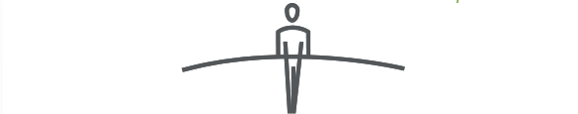
MEAL AND QUALITY
Quality is contextual - it is determined by stakeholders:
quality is the set of elements and characteristics of humanitarian assistance that support its ability to respond, on time, to expressed or implicit needs and expectations, while respecting the dignitý of the populations it aims to help. (Source : CHS – URD)
Context
Quality, efficiency, and accountability are context-specific — they depend on the different expectations of stakeholders.
Challenges
The main challenge lies in identifying the various stakeholders in a specific context and taking their specific expectations into account in a balanced way.
Stakeholders
Any person or entity can have an impact on and/or be affected by an organization, a strategy, or a project (CHS).

Slide 30
MEAL AND QUALITY
MEAL :
"Enables progress to be monitored, programmatic adjustments to be made, unforeseen effects of programs to be discovered, their impact to be judged, full responsibility and accountability for their execution to be taken, and experiences to be learned from in a logic of continuous improvement."
(Source: CRF)
Monitoring
Feedback and answers
Decision-making
Adaptation
Results and transparency
Evaluation
Institutional Knowledge
Accountability
Learning
Notes:
Source : CRF

Slide 31
Other issues surrounding MEAL
OPERATIONALIZATION
INFORMATION MANAGEMENT (IM)
DATA COLLECTION

Slide 32
OPERATIONALIZATION OF MEAL
Operationalization
MEAL actions should help put quality and accountability commitments into practice at field level.
MEAL Activities
  Budget
  Calendar
  Responsibilities
  - Team and partner capabilities

Slide 33
MEAL AND IM
What's the link between IM and MEAL?
The IM system will serve as a framework for developing MEAL activities.
As such, MEAL activities must be taken into account when developing the IM system, as they will have an impact on IM processes and responsibilities (among other aspects).
A joint IM system could be developed with partners, as in the case of multi-partner projects - it could facilitate the development of MEAL activities since information and exchanges between the various players involved in the project will be pre-identified.
BUT - It's important to take into account each partner's specific constraints and existing processes.

Slide 34
meal AND DATA COLLECTION
Each MEAL component has :
Collection tools to be developed.
Data collection processes to be respected.
Data to be collected, analyzed and used for decision-making.

Slide 35
THE PROJECT CYCLE AND meal

Slide 36
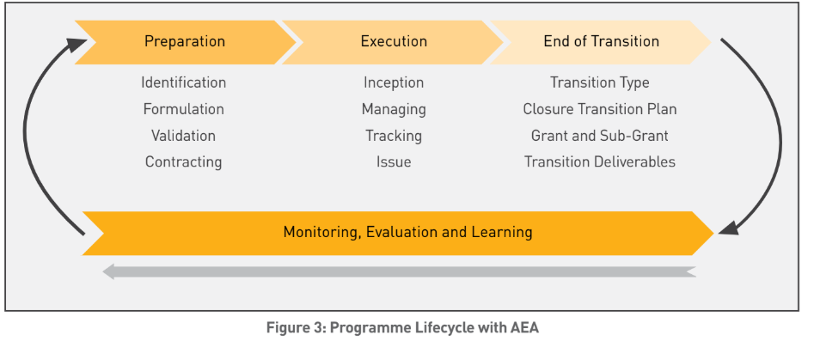
THE PROJECT CYCLE AND MEAL
How does MEAL fits into the project cycle?

Slide 37
THE PROJECT CYCLE AND meal
MEAL : an evolving process
Focus on M&E in the project cycle
Monitoring
Evaluation

Slide 38
M&E IN THE PROJECT CYCLE
GROUP 1
GROUP 2
GROUP 3
PREPARATION PHASE
EXECUTION PHASE
END-OF-TRANSITION PHASE
AS A GROUP, LIST THE ACTIVITIES AND TOOLS FOR EACH STAGE
You have 15 minutes to exchange.

Slide 39
THE PREPARATION PHASE
PREPARATION
ASSESSMENT AND NEEDS ANALYSIS
EVALUATION TOOLS
LOGICAL FRAMEWORK / CHOICE OF INDICATORS
INDICATOR BANK
FIRST VERSION OF THE
M&E PLAN
TRAME PLAN S&E
BUDGETING FOR
M&E SYSTEM
M&E BUDGET

Slide 40
THE PREPARATION PHASE
Mandatory MEAL steps in the project cycle linked to this policy:
Every project must define its logical framework and measure it at least during the course of the project:
1 effect indicator, to monitor the changes expected as a result of the intervention
Qualitative and quantitative indicators for objectives and expected results
1 accountability indicator, linked to the satisfaction of beneficiaries and people concerned

Slide 41
THE PREPARATION PHASE
Mandatory MEAL steps in the project cycle linked to this policy:
Every project must define its logical framework and measure it at least during the course of the project:
1 effect indicator, to monitor the changes expected as a result of the intervention
Qualitative and quantitative indicators for objectives and expected results
1 accountability indicator, linked to the satisfaction of beneficiaries and stakeholders

Slide 42
THE IMPLEMENTATION PHASE
INCEPTION
MONITORING & ASSESSMENT
MANAGEMENT
DATA COLLECTION
PROJECT DATABASE
BUDGETED OPERATIONAL PROJECT PLANNING MEETING AND PRESENTATION OF THE M&E
OPERATING PLAN OUTLINE
DATA ANALYSIS
DASHBOARD
DATA CONTROL, VERIFICATION AND CLEANSING
FINALIZING THE M&E PLAN
M&E PLAN
USE OF ANALYZED DATA FOR PROJECT MANAGEMENT
DATA COMPILATION / DASHBOARD UPDATE
DASHBOARD
DEFINITION OF ROLES AND RESPONSIBILITIES IN M&E (RACI)
PERIODIC FOLLOW-UP MEETING
STEERING (MONITORING PROGRESS OF ACTIVITIES, ACHIEVEMENT OF INDICATORS, TARGETS, ETC.)
RACI
M&E PLAN
USE OF DATA FOR REPORTING
REPORT FRAMES
DEFINITION OF COLLECTION TOOLS AND VERIFICATION SOURCES (SOV)
DECISION-MAKING (READJUSTMENT, UPDATING, ALLOCATION OF RESOURCES, ETC.)
QUARTERLY PROGRESS REPORT AND ANNUAL REPORT (Q4)
M&E CAPACITY-BUILDING PLAN (INTERNAL TEAM AND PARTNERS)
INFORMATION SHARING, PARTICIPATORY APPROACH WITH STAKEHOLDERS
EXTERNAL REPORTS (DONORS, NATIONAL AUTHORITIES, CONSULTATION FRAMEWORK, ETC.)
DASHBOARD SETTINGS
DASHBOARD
ADVOCACY AND INFLUENCE, EXTERNAL COMMUNICATION
INTERIM EVALUATION (PROJECT LASTING AT LEAST 3 YEARS)
EVALUATION
LAUNCH OF BASELINE STUDY
INFORMATION SHARING AND STAKEHOLDER FEEDBACK
ANNUAL PARTICIPATORY BALANCE SHEET

Slide 43
THE IMPLEMENTATION PHASE
Mandatory MEAL steps in the project cycle linked to this policy:
All projects must include an induction phase lasting between 1 and 3 months, depending on the duration of the project.
This induction phase should make it possible to carry out the necessary recruitments if they could not be anticipated;
Define project management tools and organize an inclusive launch phase with project stakeholders to allow detailed planning of activity implementation and project monitoring, evaluation and learning procedures.

Slide 44
THE IMPLEMENTATION PHASE
Mandatory MEAL steps in the project cycle linked to this policy:
All projects/programs must hold regular interdepartmental (project/support) project reviews (at least every 4 months, and necessarily aligned with the budget preparation and review cycle) to analyze and record the latest project information, identify areas of concern, and decide on any necessary changes.
Every month, the project/program manager and a member of the finance team review progress on the basis of operational and budgetary monitoring tools.
All projects must deploy feedback and complaint mechanisms specific to their areas of intervention, in line with Action Education's protection and safeguarding policy.

Slide 45
THE END-OF-TRANSITION PHASE
MONITORING
EVALUATION
LEARNING
M&E
FINAL INTERNAL OR EXTERNAL EVALUATION
M&E GUIDE
EVALUATION
DASHBOARD FINALIZATION (LAST UPDATE BEFORE ARCHIVING)
DASHBOARD
LEARNING ABOUT PROJECT M&E
M&E QUESTIONNAIRE
DEFINING EVALUATION QUESTIONS AND FORMULATING TDRS
EVALUATION
INTERNAL FINAL REPORTS
INTERNAL REPORT FRAMES
AO CONSULTANTS FOR EXTERNAL EVALUATIONS
INTERNAL AO PROCESSES
EXTERNAL FINAL REPORTS
EXTERNAL REPORT FRAMES
CONDUCTING THE EVALUATION . DATA COLLECTION
DEPOSIT FILES IN DEDICATED DRIVE / ARCHIVE
FINAL EVALUATION REPORT
EXTERNAL REPORT FRAMES
FEEDBACK TO ALL STAKEHOLDERS

Slide 46
THE END-OF-TRANSITION PHASE
Mandatory MEAL steps in the project cycle linked to this policy:
All projects must include a final evaluation, at least internal for projects less than 2 years old and external for projects more than 2 years old (subject to donor requirements).
All projects must formalize and share the lessons learned from experience, so that they can be taken into account in subsequent interventions.

Slide 47

TO REMEMBER
KEY MESSAGES M1
The M&E policy and system applies to all projects, replacing processes and tools that may have been developed by regions and/or countries.
MEAL and its tools and procedures contribute to the quality of our actions through informed decision-making.
ACTEI's MEAL policy sets out the MEAL institutional framework and the minimum MEAL requirements for all ACTEI projects at each stage of the project cycle.

Slide 48

INSTRUCTIONS INDIVIDUAL WORK

Slide 49

INDIVIDUAL WORK
1. Think individually about your project and your specific monitoring and evaluation needs.
2. In the forum, write down and list the activities and tools that you have identified as missing from your project. Be sure to make a list for each component. One list for “Monitoring” and one list for “Evaluation.
3. Prepare to present during our session on Thursday.
Contact : @secours-catholique.org
Notes:
Noter les bonnes pratiques évoquées par les participant·e·s

Slide 50

CLOSING SESSION 1
WHAT WORKS
WHAT NEEDS TO CHANGE
THEME TO BE CLARIFIED?

Slide 51
END OF SESSION 1
THANK YOU!

