Slide 1

Monitoring & EVALUATION
experiential
Training

Slide 2
The preparation phase
And the M&e
MODULE 2

Slide 3
AGENDA
I. Learning review
II. The preparation phase
III. The starting point for M&E
IV. M&E system planning - The M&E Plan
V. M&E resources and budget

Slide 4
PEDAGOGICAL OBJECTIVES - Session 2
At the end of this module, participants should be able to :
Identify the M&E steps required in the preparation phase of a project.
Identify and implement M&E tools for the preparation phase.
Assess my project's available M&E resources
Prepare an M&E plan for your project.

Slide 5
I. LEARNING REVIEW

Slide 6

KEY MESSAGES SESSION 1.
02
01
What's at stake with MEAL?
03
How MEAL contributes to the quality of ACTEI's actions.
How MEAL fits into the project cycle.
You have 10 minutes to exchange.

Slide 7
My project's M&e needs
?
What are the monitoring and evaluation requirements for my project?
Present your thoughts and the list you've prepared for your project.
You have 7 mins to present.

Slide 8
My project's M&e needs
?
How do I determine my project's M&E needs?
A number of analysis variables are available for consideration:
Strategic importance of the project
Types and number of partnerships envisaged.
Type of intervention - multi-country - consortium
Complex intervention logic.
Compliance with ACTEI M&E procedures
Specific expectations of lessors.
Source: (Inspired by Expertise France).

Slide 9
II. The preparation phase

Slide 10
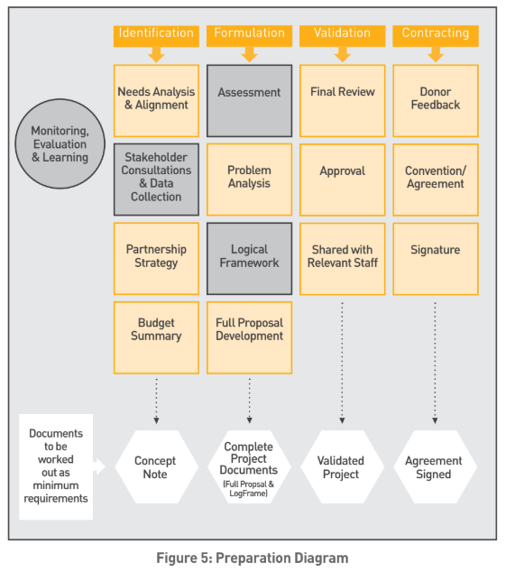
THE PROJECT CYCLE
Notes:
- Introduce each part of the project cycle and ask participants to list the activities and tools required for monitoring and evaluation.

Slide 11

WHICH M&E ACTIVITIES?
As a group, list the activities to be carried out and the tools to be used during the preparation phase.
You have 10 minutes to exchange.

Slide 12
M&E ACTIVITIES
PREPARATION
ASSESSMENT AND NEEDS ANALYSIS
EVALUATION TOOLS
LOGICAL FRAMEWORK / CHOICE OF INDICATORS
INDICATOR BANK
FIRST VERSION OF THE
M&E PLAN
M&E PLAN TEMPLATE
BUDGETING FOR
M&E SYSTEM
M&E BUDGET

Slide 13
III. The starting point for M&E

Slide 14
THE STARTING POINT
?
WHAT DO YOU THINK IS THE STARTING POINT FOR AN M&E SYSTEM?
Logical framework / Indicators
Intervention logic
ACTEI commitments - MEAL policy
lessor requirements
Notes:
BRAINSTORMING

Slide 15

The starting point
"How will we collect, analyze, interpret, use and communicate M&E information throughout the life of the project?"
(source: MEAL D Pro)
Taking into account :
Logical framework / indicators / Project narrative (project challenges)
ACTEI MEAL commitments
Lessor requirements
Identify :
Data to be collected
Monitoring activities
Evaluation activities
Notes:
Exercise response

Slide 16
STEPS IN CREATING AN M&E SYSTEM
Identify the purpose and scope of the M&E system
Plan for data collection and management
Plan for data analysis and interpretation
Plan for communication and dissemination
Plan for M&E human resources and budget
Collecte M&E
Source : Inspired from IFCR, Program Monitoring Guide, 2011.
Notes:
Explain that we're going to concentrate on this stage.

Slide 17
Intervention logic
IMPACT
Long-term changes to which the project has contributed.
EFFECTS
Short- and medium-term project outputs. Changes in development conditions.
PRODUCTS
Goods, equipment or services resulting from the project
ACTIVITIES
Actions undertaken that mobilize resources to obtain products
INTRANTS
Financial, logistical and human resources.

Slide 18
M&E ACTIVITIES
MONITORING ACTIVITIES
EVALUATION ACTIVITIES
SELECT MONITORING INDICATORS
MONITORING VISITS
SETTING UP THE DASHBOARD
ENSURE REPORTING (MONITORING OF INDICATORS)
IDENTIFY INDICATORS INFORMED BY EVALUATION
INTERMEDIATE EVALUATION (PREPARATION AND IMPLEMENTATION)
DISSEMINATION OF RESULTS
FINAL EVALUATION
OTHER SURVEYS

Slide 19
INDICATORS
Indicators are at the heart of a monitoring and evaluation system.
An indicator is a factor or variable used to measure :
Project progress,
Achieving results and objectives.
Measure the change between a baseline and an endline.
The choice of indicator also depends on the resources allocated to the monitoring system, which must be appropriate.

Slide 20
INDICATOR BANK
Action Education's catalog of indicators is designed to facilitate the formulation and monitoring of projects, based on clear, structured frames of reference.
This tool brings together :
Action Éducation's technical indicators, which respond to internal strategic priorities.
Indicators from the main institutional and financial partners, incorporating their specific requirements.
Use when creating the logical framework AND when creating the dashboard.

Slide 21
INDICATOR BANK
Organization of indicator bank columns
Column 1
Column 2
Column 3
Column 4
Column 5
Column 6
Column 7
Thematic priority
Indicator scope
Indicator labels
Definition of indicators
Cumulative ACTEI (overall)
Key action
Correspondence with donor
ECCE
Impacts
Retention rate at the end of the school year
This indicator measures the retention of pupils during the targeted school year. It tracks the contribution of improved educational conditions and environment to student retention, and to the reduction of drop-outs during the school year, particularly with regard to the implementation of meal programs/systems.
It is calculated at the end of the school year
No
Rehabilitate schools and learning environments to make them child/learner-friendly and accessible to all students
N/A
Effects
Results
Activities
Notes:
A tool organized around ACTEI's strategic prioritiesThe indicators are grouped according to the three priority themes of ACTEI's intervention strategy:
Early childhood care and education (ECCE): Priority given to innovative approaches for children aged 0 to 8 to improve their cognitive development and learning outcomes.
Access to and quality of education at primary and secondary levels: Commitment to equitable, quality education through greater government accountability and an active role for civil society.
Lifelong education and socio-professional integration: Reducing skills deficits and improving economic opportunities to strengthen the resilience and future of marginalized populations. A chain of results for coherent follow-up. The catalog covers "product", "effect" and "impact" indicators. It is based on a chain of results structured according to the monitoring-evaluation methodology:
Activities: direct actions such as training, awareness-raising or diagnostics.
Products: Tangible results (infrastructure, tools, services, capacity-building, etc.).
Effects: Measurable short- or medium-term changes (better performance, changes in schools, etc.).
Impacts: Long-term contributions to societal transformations (access to services, improved living conditions, etc.):
This column helps teams identify which indicators can contribute to aggregated monitoring of overall ACTEI results (at organizational or programmatic level).
For indicators that cannot be aggregated, the data remains specific to a project or period and should be analyzed independently.
Link to ACTEI strategy:
Cumulative indicators help to demonstrate the organization's overall impact on its priority themes, reinforcing the communication of results to partners and donors.
Non-cumulative indicators are used to assess specific states for a more detailed and contextual analysis.

Slide 22
INDICATOR BANK
Organization of indicator bank columns
Column 8
Column 9
Column 10
Column 11
Column 12
Column 13
Column 14
Type of indicator (numeric, %, etc.)
Unit (people, sessions...)
Typical disaggregations
Calculation methodology
Collection tool/SOV
Project use
Use for international direction
Percentage
Children
Gender: boys/girls.
Age range: Pre-school age range important to specify?
Geographical area: rural/urban.
# of children still enrolled at the end of the year / # of children enrolled at the beginning of the school year * 100
school register / teachers
monitoring the project's contribution to children's school continuity and reducing the number of children dropping out during the school year, context monitoring

Slide 23

INDICATOR BANK
3 Groups
Analyze the logical framework of your project and
Answer the following question: should I add internal indicators to my monitoring?
LET yourself be guided by the indicator bank
You have 20 mins.
Notes:
or match with the indicator bank / have strategic indicators for the project (cumulative)

Slide 24
IV. M&E system planning

Slide 25
The M&e plan
GROUP 1
GROUP 2
Why should a project formalize its M&E system in a document ?
What are the components of the document that would formalize the M&E system ?
You have 10 minutes to exchange.

Slide 26
The M&e plan
The M&e plan allows you to :
Align the M&E system with the challenges and needs of the project.
Define the objectives of the M&E system
Describe the project's M&E system and how it will be implemented (including technical and financial resources).
Specify data collection, analysis, use and protection processes.
Specify project tools.
Specify the various responsibilities of the project team and its partners.
Source: (Inspired by Expertise France).

Slide 27

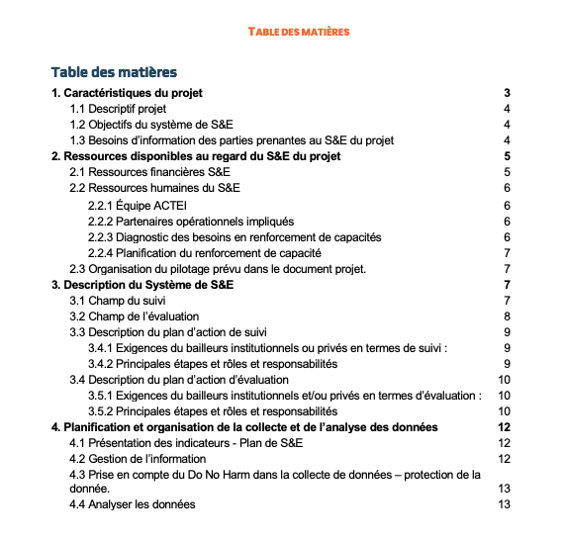
The M&e plan
Notes:
Present the tool to participants

Slide 28
The M&e plan
To Ponder Individually
The roles & responsibility?
Who does what to validate the M&E plan??
Draw up the Responsible, Accountable, Consulted, and Informed (RACI) to draw up and keep up to date the M&E Plan for your project.
The four components of a RACI matrix are Responsible, Accountable, Consulted, and Informed. Responsible refers to the individual(s) who completes the task, while Accountable is the person who ensures the task is done. Consulted are those who provide input, and Informed are those who need to be updated on progress
LET yourself be guided by the M&e plan grid
Notes:
Then a round-table discussion to listen to each participant's thoughts. 30 min

Slide 29
V. M&E resources and budget

Slide 30
My project's M&e needs
?
WHAT QUESTIONS SHOULD I ASK MYSELF TO BUDGET RESOURCES FOR MONITORING AND EVALUATION for my project?
IN PLENARY

Slide 31
The m&e resources
QUESTIONS TO ASK?
The measurement of reference and final indicator values requires the contracting of external expertise?
Local M&E expertise can be recruited to ensure day-to-day implementation of the M&E system
The project environment presents specific constraints for data collection (e.g. geographical accessibility, security).
Project/program team members have experience and skills in monitoring and evaluation.
Some implementing partners will need training to implement the m/E device
Partners and/or beneficiaries are adequately equipped (M&E system) to collect M&E data
An interim evaluation is planned and financed at mid-term by the donor*.
A final evaluation is planned and financed by the donor*.
Source: (Inspired by Expertise France).

Slide 32
BUDGET FOCUS
what are the costs to be considered when building the evaluation budget?
Notes:
p.87 / ALNAP interactive - https://www.alnap.org/system/files/content/resource/files/main/eha-pilot-alnap-2013-fr.pdf
One of the main costs of an evaluation is the total number of days of external consultancy. In general, this is the product of the size of the team and the number of fieldwork days, multiplied by the consultants' remuneration rates and daily subsistence allowances (perdiems). A budget can be divided into several phases: preparatory, fieldwork and post-fieldwork - The preparatory phase may include an initial meeting to discuss the assessment, background reading and office work, a preliminary interview at headquarters and the drafting of the inception report. The initial meeting may take 1 or 2 days, including travel time, but not all team members are obliged to attend. Background reading, preliminary interviews and the initial report can take from 1 to 5 days for a small assessment, and a month or more for a larger, more complex assessment. A small evaluation (of a single activity on a single site by a single organization) will generally take 3 to 7 days per consultant for preparatory work - Fieldwork: costs depend on the duration of fieldwork and the price of the consultants. As a general rule, quantitative methods require more fieldwork and larger teams; qualitative methods require more planning and analytical capacity. A small-scale evaluation generally takes a week of observation and interviews at the sites chosen for observation, ranging from half a week for the initial briefing to another half a week for follow-up interviews and debriefing. More time is required if there are several locations to be visited in the field, or if the team is expected to produce a report before leaving the country. A small assessment usually involves between 12 and 14 days of fieldwork; a large assessment can take months of fieldwork. As a general rule, a week's work is allowed for each country visited, and a further week for each major site (a province or district) to be visited. If the team has embarked on a detailed beneficiary consultation process, 2 or 3 weeks will be needed for each site. Quantitative survey methods are more costly and should be budgeted according to a sample and the time it will take to process and analyze the information.
PLANNING AND DESIGN- Fieldwork involves first and foremost assembling and analyzing the data collected, and then writing reports. This can include debriefing, review cycles and dissemination. Assembling data and writing reports always takes longer than the allotted time. The time required varies according to the complexity of the report and the amount of analysis required. Debriefings can take from 1 to 2 days, report writing from 1 to 20 days, and each review cycle from 2 to 10 days. When a team is made up of many members, a good rule of thumb is to add 5 days to the preparation of the report to allow the evaluation manager to incorporate their input. A small evaluation usually takes between 7 and 12 days to return from the field.

Slide 33
Cost factors to consider
Travel
Staff
Consultants
Support staff
Visas, flights for assessment team and accompanying staff, flights for meetings, internal travel for team and accompanying staff
Staff salaries and allowances, partner staff allowances and other staff.
Team leaders, international consultants, national consultants, other consultants
Remuneration and allowances for administrative staff, researchers, interpreters, drivers, security personnel, etc.
Other
Daily benefits
Report production
Communication, e-mails and post, teleconferences, licenses and legal fees, security.
Data entry
Meetings and workshops
Venue rental, meals and allowances.
Accommodation and per diem for consultants
Data entry and cleaning to remove answers that don't make sense, such as someone recorded as both male and pregnant.
Venue rental, meals and allowances.
Notes:
ALNAP interactive - p.89/Table 8 (https://www.alnap.org/system/files/content/resource/files/main/eha-pilot-alnap-2013-fr.pdf)
@Sandra: / animation - make the elements appear as you go along

Slide 34
The M&e resources
Which budget lines?
HR M-E project dedicated local
M-E coordination Department/Country
External M-E beaded expertise
Baseline/endline
Interim evaluation mission
Final evaluation mission
Coordination/monitoring missions
M&E workshops/meetings/trainings
Data collection services (surveys, studies, etc.)
Tools for data collection, analysis and visualization

Slide 35
The M&e budget
INDIVIDUALLY
Analyze your project budget and identify the budget earmarked for M&E
LET the budget questions be your guide
You have 20 mins.
Notes:
Then a round-table discussion to listen to each participant's thoughts. 30 min

Slide 36

TO REMEMBER
KEY MESSAGES S2
The logical framework, MEAL policy and donor requirements serve as a starting point for defining the M&E activities to be programmed.
M&E activities must be planned and scheduled in the same way as project activities. This involves defining the M&E activities to be carried out and budgeting for them using the M&E PLAN.

Slide 37

INSTRUCTIONS INDIVIDUAL WORK

Slide 38

INDIVIDUAL WORK
1. Think individually about your project and formalize the monitoring and evaluation process.
2. Fill in the M&E Plan template, with the help of colleagues from your team as you see fit.
3. If you have any questions during your work, post them in the forum
4.Post the completed document in the forum.
Contact : @secours-catholique.org
Notes:
Noter les bonnes pratiques évoquées par les participant·e·s

Slide 39
END OF SESSION 2
THANK YOU!

