Slide 1

Monitoring & EVALUATION
Training
experiential

Slide 2
The implementation phase
And the M&e
MODULE 3

Slide 3
AGENDA
I. Learning review
II. The implementation phase and M&E
III. Inception phase and the indicator’s quality
IV. Dashboard

Slide 4
PEDAGOGICAL OBJECTIVES - Session 3
At the end of this module, participants should be able to :
Identify the M&E steps required in the implementation phase of a project.
Identify and set up M&E tools for the implementation phase - Inception phase.
Assess the quality of project indicators.
Prepare the M&E dashboard for your project.

Slide 5
I. LEARNING REVIEW

Slide 6
A look back at the M&e plan.
Presentation of the assignment?
Have you encountered any particular difficulties?

Slide 7
II. The implementation phase and M&E

Slide 8
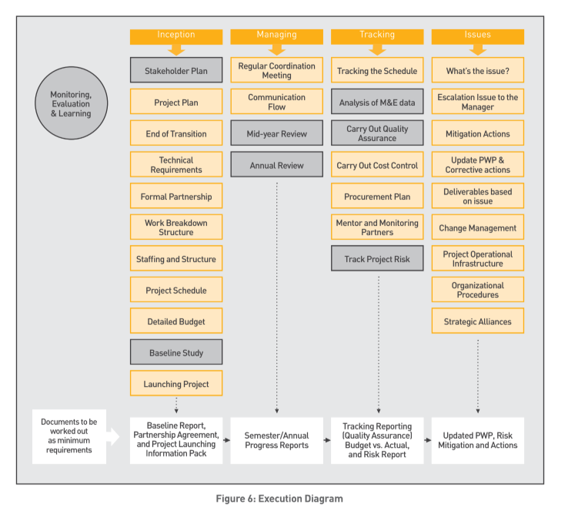
THE PROJECT CYCLE
Notes:
- Introduce each part of the project cycle and ask participants to list the activities and tools required for monitoring and evaluation.

Slide 9


WHICH M&E ACTIVITIES?
As two group, list the activities to be carried out during the inception phase, and identify the activities that are missing from a project.
You have 10 minutes to exchange.

Slide 10
WHICH M&E ACTIVITIES?
INCEPTION
PARTNERS
Kick-off meeting
Project presentation documents.
Formalizing partnerships
Partner training Follow-up
MONITORING
HUMAN
RESOURCES
Setting up the monitoring system
Preparation of the project monitoring toolbox.
Training teams in the monitoring system
Recruiting, training and briefing teams
Development of a human resources plan
EVALUATION
LOGISTICS
Identification of indicators to be informed by the evaluation
Ensure logical aspects of Follow-up (tablets or other)

Slide 11
THE IMPLEMENTATION PHASE
INCEPTION
BUDGETED OPERATIONAL PROJECT PLANNING MEETING AND PRESENTATION OF THE M&E
OPERATING PLAN OUTLINE
FINALIZING THE M&E PLAN
M&E PLAN
DEFINITION OF ROLES AND RESPONSIBILITIES IN M&E (RACI)
RACI
M&E PLAN
DEFINITION OF COLLECTION TOOLS AND VERIFICATION SOURCES (SOV)
CAPACITY-BUILDING PLAN (INTERNAL TEAM AND PARTNERS)
DASHBOARD SETTINGS
DASHBOARD
LAUNCH OF BASELINE STUDY

Slide 12
THE IMPLEMENTATION PHASE
Mandatory MEAL steps in the project cycle linked to this policy:
All projects must include an induction phase lasting between 1 and 3 months, depending on the duration of the project.
This induction phase should make it possible to carry out the necessary recruitments if they could not be anticipated;
Define project management tools and organize an inclusive launch phase with project stakeholders to allow detailed planning of activity implementation and project monitoring, evaluation and learning procedures.

Slide 13
III. M&E start-up - the quality of indicators

Slide 14
INDICATORS
Indicators are at the heart of a monitoring and evaluation system.
An indicator is a factor or variable used to measure :
Project progress,
Achieving results and objectives.
Measure the change between a baseline and an endline.
The choice of indicator also depends on the resources allocated to the monitoring system, which must be appropriate.

Slide 15
QUANTITATIVE OR QUALITATIVE
It expresses quantitative or qualitative data
1.observables (existence or absence)
2. Measurable (value, quantity)
Enable comparison
1. Value scale
2. Public perceptions
Allow an understanding of feelings
Number of teachers available per 1000 inhabitants in the intervention area.
% of population in intervention area who consider education services sufficient

Slide 16
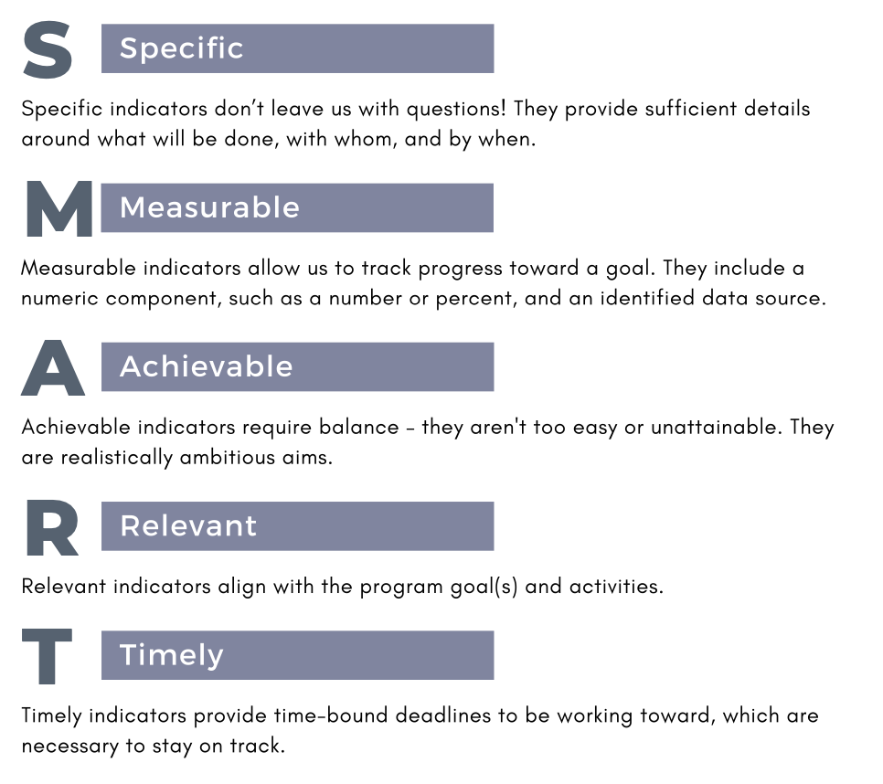
SMART
Notes:
increasing the percentage of students passing a standardized test by 15% within two years, or reducing the student dropout rate in a specific school by 10% within one year

Slide 17
SMART INDICATORS
TURN THE INDICATOR INTO A SMART
GROUP 1
GROUP 2
In a group,
TRANSFORM :
"Strengthening the voice of civil society on education issues".
In a group,
TRANSFORM :
"Number of people trained
You have 15 minutes to exchange.

Slide 18
SMART
GROUP 1
GROUP 2
Number of individuals belonging to associations, collectives & NGOs on the theme of education.
Annual budget of these organizations on the theme of education.
Number of department heads who have completed the training.
Notes:
Exercise response

Slide 19
INDICATOR LEVELS
INDICATOR levels
THE RESULTS CHAIN
IMPACT
Impact
Indication at the end of the project that a dynamic has been triggered
  Long-term changes to which the project has contributed.
EFFECTS
  Short- and medium-term project outputs. Changes in development conditions.
Effects
Signs that end-users are satisfied (use) the products to change their behavior/skills
PRODUCTS
  Goods, equipment or services resulting from the project
Products
Signs that show product quantity and quality
ACTIVITIES
  Actions undertaken that mobilize resources to obtain products
Activities
Signs related to the execution of work plans (project management)
INTRANTS
  Financial, logistical and human resources.
Best practice: maximum 3 indicators per cell in the results chain
Notes:
Terminology: OECD DAC definitions
Three level of results: impact, effets et produits : Impact (impact)/effets (outcome)/produits (outputs (it used to be called results, but this has just changed because we also have results or we can contribute to results at the level of effects and impact)/activities/inputs (inputs).
1. Impact: long-term change, in the community, in the country... many partners and actors in the context will contribute to this. It's not under our influence, but we have to monitor it to see if it's consistent with our project.
2. Effects are elements of change in a situation that are not directly under the control of our project. For example, a change in the behavior of our beneficiaries or partners.
My target groups are in control, and with the products I try to influence how they behave. These are the desirable effects of the project. The evaluation will say whether or not we've had an influence and in what direction. Not in control, but the project is responsible for achieving them.
3. Products: this is really what the project will leave behind after the intervention. We need to be very comfortable with this because an evaluation is going to focus on the achievement of outputs (did we really do (deliver, build....) what we said we would. And if not, why not?

Slide 20
INDICATOR levels
For each indicator below, please indicate whether it is an activity, output, effect or impact indicator:
Increase in school enrolment rates
Number of teacher training courses
% of capacity-builders who found a job opportunity within three months of receiving support
Number of people who have benefited from training who show an improvement in their practices.
Notes:
Ask participants to write on the chat:
1/ IMPACT (EFFECT)
2/ ACTIVITY
3 / EFFECT
4 / PRODUCTS

Slide 21
The dashboard
Indicators - what: Name or title of the indicator. It summarizes in a few words the objective or dimension being measured.
Indicator definition and unit of measurement - what +++: Provides a detailed and precise explanation of the indicator, clarifying its components, scope and purpose.
Cumulative ACTEI: indicates whether an indicator can be cumulated across ACTEI projects. This means that the data collected for this indicator can be added up over several time periods or between several projects to obtain a relevant overall total.
Indicator type: Specifies the nature of the data collected.
Disaggregations: Levels or categories according to which data can be broken down for finer analysis. Example: Gender, age group, geographical area
Data collection tools and methods - how: Explains how the indicator value is obtained, detailing the calculation steps or formulas.
Frequency and schedule - when: How often or when is the training to be collected?
Persons responsible - who (who collects, who holds the information) : Specify from whom the information will be collected, who is the source of the information, who holds it, who analyzes it.

Slide 22
IV. Dashboard

Slide 23
The dashboard
During the implementation phase, we will be collecting data to monitor the project.
To plan this data collection, it is useful to specify what needs to be monitored.
Discover the tool: dashboard
  It explains the process for collecting the data and indicators that will demonstrate the project's success.
  It serves as a data analysis and steering tool for project results.
  It will enable information to be shared with all project stakeholders (internal, but also partners if necessary).

Slide 24
The dashboard
the composition of the dashboard.
A 5-tab tool: which ones!

Slide 25
The dashboard
Tab 1 - Project information :
Tab 2 - Project assessment and analysis :
Tab 3 - Action plan/Chronogram :
Tab 4.1 - Monitoring & Evaluation Plan
Tab 4.2 - Indicator monitoring
Tab 4.3 - Beneficiary follow-up
Tab 5 - Monitoring budget achievements

Slide 26

The dashboard
2 groups
Analyze your project's logical framework and choose ONE indicator to fill in the dashboard - definition and calculation method.
Using its logical framework, complete the dashboard M&E plan
LET yourself be guided by line 4 of tab 4.1
Use the dashboard template - and the bank of indicators if necessary
You have 20 minutes.

Slide 27

TO REMEMBER
KEY MESSAGES S3
The start-up phase is essential to ensure that tools and processes are set up and that the project gets off to the right start.
The quality of the indicators and work on the dashboard to define the indicators is essential for monitoring and steering the project.
The dashboard is a project management tool.

Slide 28

INSTRUCTIONS INDIVIDUAL WORK
FOR SECTION 4

Slide 29

INDIVIDUAL WORK
1. Reflect individually on your project and set up the dashboard using the data in the logical framework.
2. Fill in tabs 1, 4.1 and 4.2 of the dashboard with the help of any colleagues from your team you deem necessary.
3. If you have any questions during your work, post them in the forum for this job.
Contact: @secours-catholique.org @secours-catholique.org
Notes:
Note the good practices mentioned by participants

Slide 30
END OF SESSION 3
THANK YOU!

