Slide 1

Training
experiential
Monitoring & EVALUATION

Slide 2
Monitoring & EVALUATION
MODULE 4

Slide 3
AGENDA
I - Collective reminder of the dashboard's objectives
II - The challenges of setting dashboard parameters - Using and manipulating Excel
III - Data collection
Notes:
Check session 3 - dashboard presentation - to be updated

Slide 4
PEDAGOGICAL OBJECTIVES - Session 4
At the end of this module, participants should be able to :
Finalize project dashboard settings.
Setting up and using the dashboard (Excel)
Preparing your project dashboard
Identify the M&E processes and tools to be used in the implementation phase
Identify the basic elements of data collection.
Notes:
Exchange with participants to check ownership of dashboard objectives - 5 minutes

Slide 5
I - Revision/reminder module 3

Slide 6
REMINDER OF THE DASHBOARD'S OBJECTIVES
?
WHAT DO YOU THINK ARE THE OBJECTIVES AND USES OF THE DASHBOARD?
What's it for?
Contact: @secours-catholique.org @secours-catholique.org
Experience feedback (Q&A)
How did you fill in the dashboard?
Have you encountered any particular difficulties?
Notes:
Exchange with participants to check ownership of dashboard objectives - 5 minutes

Slide 7
II - THE CHALLENGES OF SETTING DASHBOARD PARAMETERS

Slide 8

Why do I need to set parameters?
Each project has its own specific challenges: dates, durations, themes, selection of indicators......
So it's not possible to harmonize formulas upstream, because they wouldn't work for every project!
To optimize use of the dashboard, certain formulas need to be configured.
Setting formulas will enable you to view analyses and balances in Tab 2 and automate all data calculations.

Slide 9
EXCELS PARAMETER-SETTING FUNCTIONS
?
What can you do in Excel?
Overview of knowledge and skills
Contact: @secours-catholique.org @secours-catholique.org
Notes:
or make a quiz beforehand - in the previous session?

Slide 10
EXCELS PARAMETER-SETTING FUNCTIONS
Master basic calculations, functions and formulas: number; nb.si; sums... ;
Extract and link data from different tabs
Setting up and modifying a diagram
What will you need to set up your dashboard?
Barbarous names but simple things!

Slide 11


EXERCISES - EXCELS FUNCTIONS
INDIVIDUALLY
In the dashboard - a few formulas/functions are already set up. Can you find one and describe it to us?
Function type: (sum; number....)
Ranges taken into account by the formula: (Row/column number)
As a project manager or M&E manager, what does this mean to you?
You have 5 mins.
Notes:
Optional - Interview two or three participants - no more than 10 min.

Slide 12
BASIC FORMULAS AND FUNCTIONS
SUM
NUMBER
Adds data
=SUM(range)
=SUM(A5:L5)
Counts a number of data
= NB(range)
=NB(A5:L5)
SUM IF (condition)
NUMBER IF (condition)
MULTIPLE CONDITIONS
=SUM.SI(criterion application range; "criterion";calculation range)
=SUM.SI(L1:P1; "Yes";L6:P6)
=SUM.SI(L1:P1;"<5";L1:P1)
= NB.IF (criterion application range; "criterion";range to be counted)
=NB.SI(L1:P1; "Yes";L6:P6)
=NB.SI(L1:P1;"<5";L1:P1)
=SUM.SI.ENS(1st criterion application range; "1st criterion";2nd criterion application range; "2nd criterion";calculation range)
=NB.SI.ENS(L1/P1; "Yes";L8:P8; "F";L10:P10)
Description
Description
Description
Notes:
Show directly in excel

Slide 13
BASIC FORMULAS AND FUNCTIONS
NB.EMPTY
AVERAGE
=NB.EMPTY (range)
counts the number of empty cells in the range
Calculates an average
= AVG(range)
=AVG(A5:L5)
Description
Description
Description

Slide 14
EXERCISES - EXCELS FUNCTIONS
INDIVIDUALLY
Go to tab 4.2 - Indicator tracking on your dashboard.
Column H - Reached
A sum function is pre-parameterized
However, not all indicators necessarily correspond to a sum.
Set the formulas in column H of each indicator
=> calculation information can be found in column C Calculation method
You have 15 minutes.
Notes:
Show an example of the case study - Participants complete a few indicators - they won't be able to do everything during the exercise - that's normal - point out that they'll continue with individual work later - At the end of the exercise, ask what difficulties were encountered - take notes - repeat that we'll come back to this as we go along.

Slide 15

FOCUS ON ANALYSIS FUNCTIONS
Tab 2 - Summary and analysis of the dashboard is designed to facilitate certain analyses of data from the other sheets.
Two levels of analysis:
Project management data
Project data
Visual analysis of key indicators: beneficiaries and cumulative indicators ACTEI
Partly already configured
Visual analysis of project implementation data (activities, budget, etc.)
Partly already configured
Notes:
Show tab 2 - dashboard - case study example

Slide 16
EXERCISES - EXCELS FUNCTIONS
Can you draw a diagram?
Tab 2: Assessment and analysis - Beneficiaries/people of concerned follow-up section.
This data is linked to tab 4.3, total table (bottom).
The diagram is set up to include all types of beneficiary profiles and focuses on gender criteria only.
Based on your own project, modify the diagram to show the information/criteria that's relevant to you.
You have 15 minutes.
Notes:
Demonstrate the dashboard - showing Tab 4.3 and the total automatic table - and link it to the diagram in Tab 2.

Slide 17

TIPS
Keep a regular back-up of the dashboard
Format cells as much as possible: drop-down list / cell format....
Reduce the number of people who can edit online and offer read-only access

Slide 18
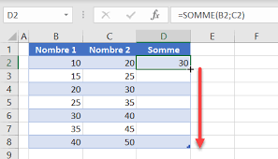

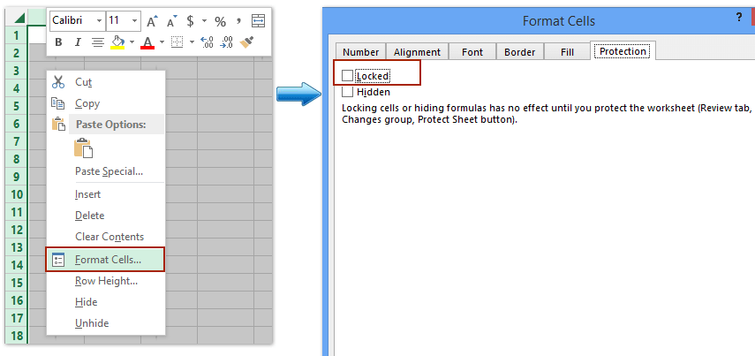
TIPS
To make certain data easier to read - use the filter function to isolate certain rows. Note that the filter function does not work if cells are merged.
Extend/stretch a formula
Protect and lock certain cells or ranges - to limit the risk of modifications

Slide 19
III - DATA COLLECTION

Slide 20
THE IMPLEMENTATION PHASE
START-UP
(Inception Phase)
MONITORING & ASSESSMENT
MANAGEMENT
DATA COLLECTION
PROJECT DATABASE
BUDGETED OPERATIONAL PROJECT PLANNING MEETING AND PRESENTATION OF THE SE
OPERATING PLAN OUTLINE
DATA ANALYSIS
BOARD LAYOUT
DATA CONTROL, VERIFICATION AND CLEANING
FINALIZING THE S&E PLAN
TRAME
M&E PLAN
USE OF ANALYZED DATA FOR PROJECT MANAGEMENT
DATA COMPILATION / DASHBOARD UPDATE
BOARD LAYOUT
DEFINITION OF ROLES AND RESPONSIBILITIES IN S&E (RACI)
PERIODIC FOLLOW-UP MEETING
STEERING (MONITORING PROGRESS OF ACTIVITIES, ACHIEVEMENT OF INDICATORS, TARGETS, ETC.)
RACI
M&E PLAN
USE OF DATA FOR REPORTING
REPORT FRAMES
DEFINITION OF COLLECTION TOOLS AND VERIFICATION SOURCES (SOV)
DECISION-MAKING (READJUSTMENT, UPDATING, ALLOCATION OF RESOURCES, ETC.)
QUARTERLY PROGRESS REPORT AND ANNUAL REPORT (Q4)
M&E CAPACITY-BUILDING PLAN (INTERNAL TEAM AND PARTNERS)
INFORMATION SHARING, PARTICIPATORY APPROACH WITH STAKEHOLDERS
EXTERNAL REPORTS (DONORS, NATIONAL AUTHORITIES, CONSULTATION FRAMEWORK, ETC.)
DASHBOARD SETTINGS
BOARD LAYOUT
ADVOCACY AND INFLUENCE, EXTERNAL COMMUNICATION
INTERIM EVALUATION (PROJECT LASTING AT LEAST 3 YEARS)
TRAME TdR EVALUATION
LAUNCH OF BASELINE STUDY
INFORMATION SHARING AND STAKEHOLDER FEEDBACK
ANNUAL PARTICIPATORY BALANCE SHEET
Notes:
Situate the training stage in relation to the SE diagram

Slide 21
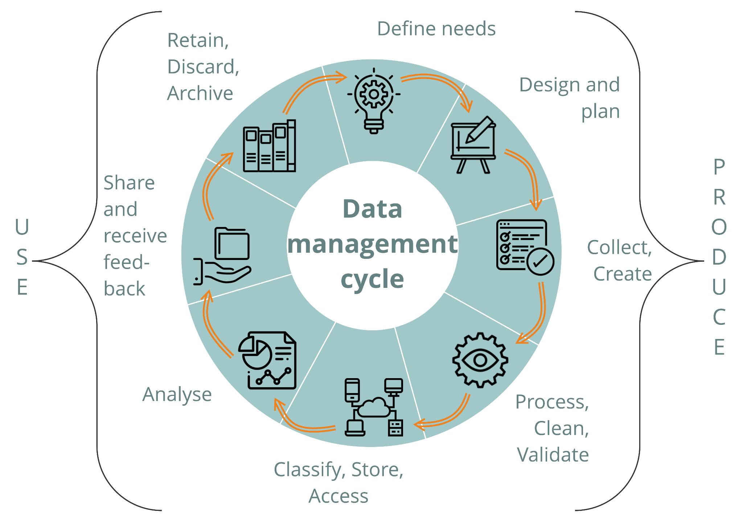
DATA CYCLE
source CartONG
Notes:
The data cycle is integrated into the M&E cycle, and includes the same stages.

Slide 22
DATA CYCLE
Data collection is part of the data cycle.
Once the planning has been carried out in the M&E plan (tab 4.1 of the dashboard and Monitoring and Evaluation System (word document))
The question is HOW will the indicators be filled in? How will the data be obtained?
What tools are we going to use?
What methods will we use?

Slide 23
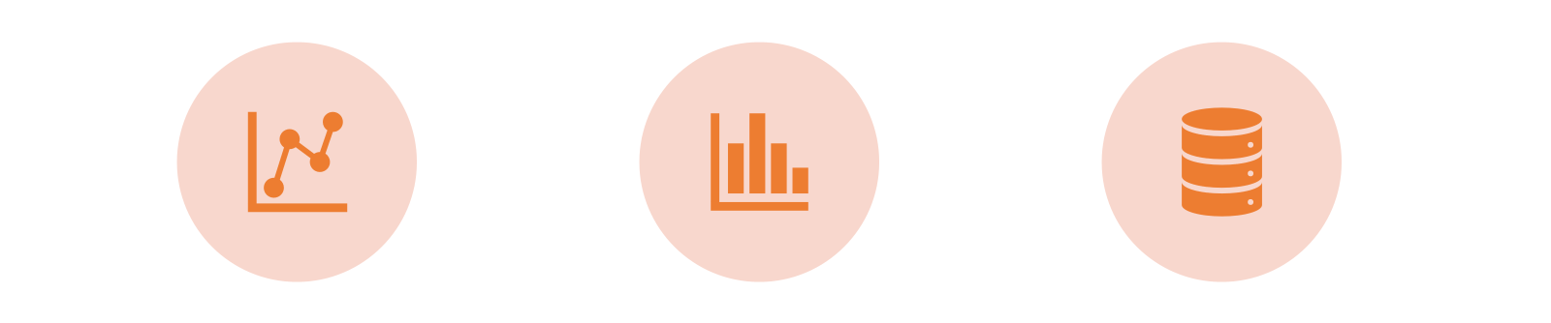
DATA VS. INFORMATION
Data refers to raw facts or figures before they are processed and analyzed.
Information refers to processed and analyzed data intended for reporting and decision-making
Data is transformed into information when it is structured and given meaning

Slide 24

DATA COLLECTION - EXCHANGE TIME
(3 Groups)
What are your experiences of data collection? How are you used to collecting data?
What are the main difficulties and constraints you have encountered?
What are the best practices, tools and methods that work well?
Notes:
Collect the practices, tools and methods used by participants - Note the main methods used by participants

Slide 25
DATA TYPES
2 main data families :
Primary data: new, directly collected data
Secondary data: pre-existing data available from various sources (authorities, ministries, schools, UN, reports from other players, etc.).
4 types of data :
Quantitative data
Numerical data that indicate things that can be measured or counted
Qualitative data
Descriptive data providing information on attributes, categories, typologies and descriptions of phenomena.
Geographic/spatial data
GPS data, geolocation...
Audiovisual data (photos, videos, audio, etc.)
Notes:
It is important to check the reliability of secondary data and to identify possible biases. Primary data correspond to data produced directly during the project.

Slide 26
THE DIFFERENT METHODS
Quantitative" data collection methods: make it possible to extract statistical information on a given situation, and must therefore be representative of the target population.
Qualitative methods: aim to put issues, problems and results into perspective, to include a subjective dimension through the perception of different stakeholders, and to provide details on a situation, a result or a context. There are several types of qualitative studies: observation, semi-structured interviews, focus groups.

Slide 27
DIFFERENT TOOLS: quaNTITATIVE METHODS
The main method for collecting quantitative data is the survey. The most commonly used are :
Baseline/Midline/Endline surveys
Knowledge, Attitudes and Practices (KAP) surveys
Satisfaction surveys
A survey is a technique for collecting data by applying a questionnaire to a sample of individuals. In order for the survey to be representative of the program/intervention target population, it must be carried out with a representative sample of individuals.
The tools used will need to be adapted to the target audience, especially if children are involved.
Who is the target population, and what tools are most appropriate? What medium should be used (tablet, paper, etc.)?
Notes:
For children, diversify the methods with drawings, different techniques exist.

Slide 28
DIFFERENT TOOLS: quaNTITATIVE METHODS
There are also tools or sources for checking quantitative data: these are not collection tools per M&E, but media that enable you to record various quantitative information related to the project.
For example, an activity follow-up sheet that tracks the number of sessions carried out, an attendance sheet that tracks the number of participants in a training session, individual child follow-up sheets or pre&post training tests...
Questions to ask: are sources of verification available to teams and partners, and where are they archived or recorded (database, dashboard, etc.)?

Slide 29
THE DIFFERENT TOOLS: QUALITATIVE methods
Interviews: Conversation between an interviewer and a respondent (interviewees, informants or sources) during which questions are asked in order to obtain information. Open-ended or semi-structured interviews. The aim is to gather a person's point of view, based on his or her role, profile, responsibilities...
Questions to ask yourself: interview grid with open-ended questions to open up discussion; length of interview
Focused discussion groups: Open discussion on a particular topic based on an interview guide with a small group of people (between 8 and 12) supervised by a facilitator (recommended a pair to observe group dynamics and take notes).
Questions to ask: composition of the group, mixed or single-sex, trust and benevolence, attention to power dynamics that may exist, attention to balanced participation.
Notes:
For children, diversify the methods with drawings, different techniques exist.

Slide 30
THE DIFFERENT TOOLS: QUALITATIVE methods
Observation: Observation is a means of gathering data by observing behavior, events or noting characteristics in an environment (e.g. observation of teachers' teaching practices, observation of changes in the school environment (maintenance of sanitary facilities, safety, etc.).
Questions to ask: define an observation grid and possible common criteria.
Participative facilitation: participative methods that facilitate the exchange of perspectives, experience sharing, analysis, learning and action. It can take the form of a workshop, inviting participants to discuss and reflect collectively on the subject. They can help build a shared vision of the situation, and provide an opportunity to cross-reference different points of view (points of convergence and divergence).
Questions to ask: define the participants, the place and objective of the collective reflections, and the time required.
Notes:
For children, diversify the methods with drawings, different techniques exist.

Slide 31





COMPLEMENTARY TOOLS
Data collection tools | Quantitatives | Qualitatives | Qualitatives (media)
Focus-group discussions | Possible | well adapted | Possible (audio record)
Key informants interviews |  | well adapted | Possible (audio record)
Observation |  |  | Well adapted : pictures, recording, drawing
Data collection - paper form | Mostly, well adapted | Possible, but less adapted and more limited compared to interviews | Possible but less than mobile data
Data collection - digital tools | Mostly, well adapted | Possible, but less adapted and more limited rather than interviews | Well adapted : pictures, recording, drawing
Notes:
These data collection methods are not exclusive, but complementary! Good qualitative and quantitative data collection relies on different collection methods, in order to be able to triangulate the information received.

Slide 32
Focus on SAMPLING
Depending on requirements, it may be necessary to sample the target population: why?
It's difficult to reach the entire target population - for example, at the end of the work integration program, it will be complicated to survey each young person individually, as some may have left the area (difficult to track them down).
The team is not sufficiently available to collect and analyze too much data (resource and feasibility issues) - The team does not have the resources to process all the questionnaires on changes in parenting practices.
It's best to focus on sampling the target population to ensure data quality, analysis and use.
Notes:
Section on sampling to be developed more or less according to time and participants.

Slide 33
Focus on SAMPLING
Some basic principles of sampling :
The sample is a subset of the target population. It must be representative of this population
Principles of representativeness :
Calculate a few descriptive statistics for the target population to ensure that there are no major differences with the population structure (age, sex, municipality, educational level, social conditions, ethnicity, etc.). In the dashboard, tab 2- Assessment and analysis, you have a "photo" of the populations concerned which you can use to calculate your sampling.
Example: the project involved 65% girls and 35% boys => your sample should be composed of the same ratio.

Slide 34
Focus on SAMPLING
Sampling methods
Non-random methods | Random methods
Choice based on convenience, accessibility, reasoned choice, quotas, self-selection, volunteering | Random selection, e.g. from database
Limits representativeness and the application of different criteria (location, age, etc.), which can bias the observation, but can also meet research objectives. | Enables statistically representative results to be obtained, but is not always feasible, as it requires sufficient information on the target population and considerable work to calculate sample size and all representativeness criteria.
To find out more: https://cartong.pages.gitlab.cartong.org/learning-corner/fr/2_getting_started_data_analysis/2_4_starting_analysis/2_4_3_plan#echantillonnage
Notes:
Sampling methods are numerous and sometimes complex - to go further is a resource that provides more detail than can be covered here.

Slide 35
How do I choose the right tools?
To define the most appropriate tools?
Skills within your team and those of your partners
Time: how much time do you have to devote
Available analysis tools: do you have access to tools that will help you study the data? Will the database work, the dashboard? Will the automatic analysis of the form be sufficient? If you opt for digital tools, do you have the skills in-house?
Who is your target audience, who will respond, what is their profile and their level of commitment to the collection process (do they agree to answer the questions)? How can you adapt tools and techniques, especially for children?
Notes:
Target audience: with children, for example, you can't have the same dynamic as with adults;

Slide 36
EXERCISE
INDIVIDUALLY
Let's take a moment to complete your M&E plan, tab 4.1, based on the latest data collection elements.
Take 10 minutes to complete column P: What tool or method or source of verification should be used to collect the information?
You have 15 minutes.
Notes:
At the end of the exercise - open up an exchange with participants - difficulties, questions or anything else

Slide 37
DATA COLLECTION
QUESTION/ANSWER?
Notes:
Exchange with participants on the data collection session

Slide 38

TO REMEMBER
KEY MESSAGES
Excel dashboard :
Using the dashboard requires some Excel skills, otherwise its functionality will be limited.
Dashboard formulas must be set up at the start of the project.
Data collection :
Two main types of data: primary and secondary
Two main types of data: qualitative and quantitative
A variety of complementary collection methods and tools
Importance of adapting tools and methods to the target audience, especially children

Slide 39
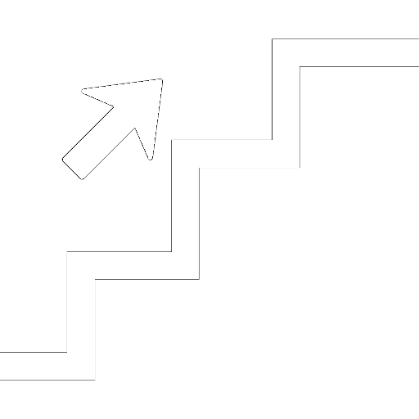
Next module
Data collection - continued :
Focus on questionnaire design
Data quality and control
Data protection
Analysis and use of data :
Data analysis principles
Main uses of information for the project
Information path :
Information sharing and communication flows

Slide 40

INSTRUCTIONS INDIVIDUAL WORK

Slide 41

INDIVIDUAL WORK
Continuing work on dashboard settings
Setting formulas for indicator monitoring, tab 4.2, column H
Revision of tab 4.1 M&E plan - column P to define collection methods
Tab 2 settings -Balance and Analysis
Contact: @secours-catholique.org @secours-catholique.org
Notes:
Note the good practices mentioned by participants

Slide 42
END OF SESSION 4
THANK YOU!

