Slide 1

Training
experiential
Monitoring & EVALUATION

Slide 2
Monitoring & EVALUATION
MODULE 5

Slide 3
AGENDA
I - Data collection (continued) / focus on questionnaires
II- Data control
III- Analysis and use
IV- Information path
Notes:
Check session 3 - dashboard presentation - to be updated

Slide 4
PEDAGOGICAL OBJECTIVES - Session 5
At the end of this module, participants should be able to :
Tips for preparing a quality questionnaire
M&E implementation - data collection / dashboard use
Use table data for analysis, dialogue and decision-making
Use dashboard data for reporting and analysis.
Identify and implement the information path - the dashboard.
Notes:
Exchange with participants to check ownership of dashboard objectives - 5 minutes

Slide 5
Experience feedback
QUESTION/ANSWER?
How did you fill in the dashboard?
Have you encountered any particular difficulties?
Notes:
Open up time for questions and answers on the individual work carried out: preparation of the dashboard - depending on the questions/difficulties - use the support from session 4 or use demonstrations on the dashboard and the case study.

Slide 6
I - data collection (continued)

Slide 7
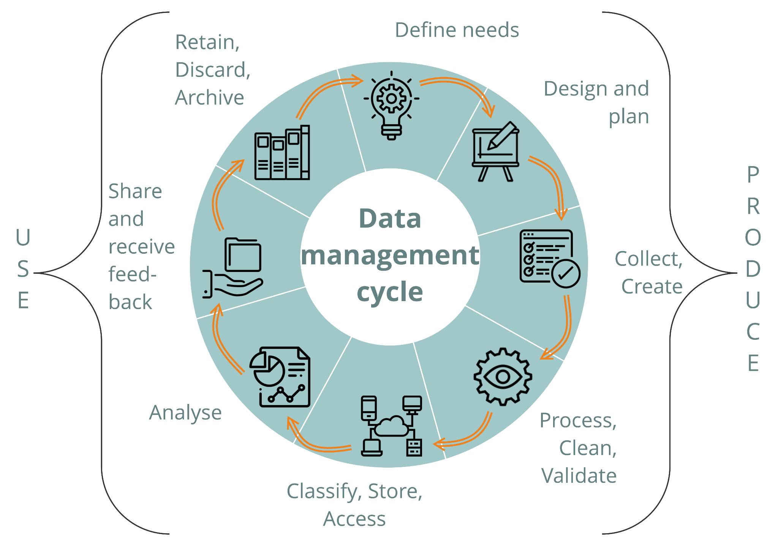
DATA CYCLE
source CartONG
Notes:
Situate the stage in the data cycle

Slide 8
DESIGNING TOOLS
?
Reminder of module 4
What methods and tools can you use to collect data?
Contact: @secours-catholique.org @secours-catholique.org
Notes:
Exchange with participants to check ownership of information concerning data collection in module 3 - 5 minutes

Slide 9

DESIGNING TOOLS - FOCUS ON THE QUESTIONNAIRE
Checklist and tips for designing a form
Checklist | Explanations
Formulate understandable questions, with as little technical jargon as possible. Example: DE can have several meanings: Droit de l'enfant vs Diplôme d'Etat | Avoiding misconceptions and facilitating the appropriation of the form by teams and new interviewers by making the survey self-explanatory In multilingual contexts, this will also facilitate translation. Don't hesitate to add clues to explain the necessary definitions, or to replace text values with images where this can be useful. During training, use concrete examples, role-playing or answer standardization tests to ensure that everyone has the same understanding of the strategic questions.
Do not attempt to merge questions to reduce the total number of questions. | This complicates the answer and its analysis. So avoid double questions Example: Are there any disabled and/or elderly people, and if so, how many? Replace with: number of disabled people / number of elderly people

Slide 10
DESIGNING TOOLS - FOCUS ON THE QUESTIONNAIRE
Checklist and tips for designing a form
Checklist | Explanations
Avoid free-text answers | This complicates the analysis, as it requires individual reading of each answer. If necessary, specify a short answer or key words. Prefer standardized answers, with a choice of answers (response options already formulated) that will make analysis easier.
Limit multiple-choice answers | They may appear to be an option, but their analysis requires a great deal of manipulation (filtering, cross-referencing of data and information), which can make analysis more complex and require technical skills.
Keep the question neutral: don't try to influence the respondent. | This will obviously bias the results by encouraging an answer that may not be true.

Slide 11
DESIGNING TOOLS - FOCUS ON THE QUESTIONNAIRE
Checklist and tips for designing a form
Checklist | Explanations
Make sure your survey flows logically from one question to the next, and from one group of questions to the next. | This makes it easier for the respondent to read and understand. If they get lost in the questions, they may abandon the form.
Contextualize issues that may directly affect the people concerned. Example: "Are you satisfied with services provided to your family ? “ | If you don't explain that the answer to this question will have no impact on any additional help you may be able to provide, you run the risk of obtaining a highly underestimated result...

Slide 12
DESIGNING TOOLS - FOCUS ON THE QUESTIONNAIRE
Checklist and tips for designing a form
Checklist | Explanations
Consider the reasons for making questions compulsory | Certain questions can be made compulsory, to improve the quality of the analysis. However, the following questions should be considered: for technical reasons (especially on mobile devices) where certain data (GPS, for example) may not work, thus blocking the rest of the form; some questionnaires depend on several people. If they are not available at the time of the survey, it will not be possible to complete the form; if you're not sure about the suggested answers, or even the relevance of the question, it's best to leave it open-ended. Failure to answer a question is in itself data that you can analyze: the question is not well formulated, the subject of the question is not perceived by the people concerned.... people might be tempted to answer randomly, without conviction, and move on to the next question, which would skew the quality of the data.

Slide 13
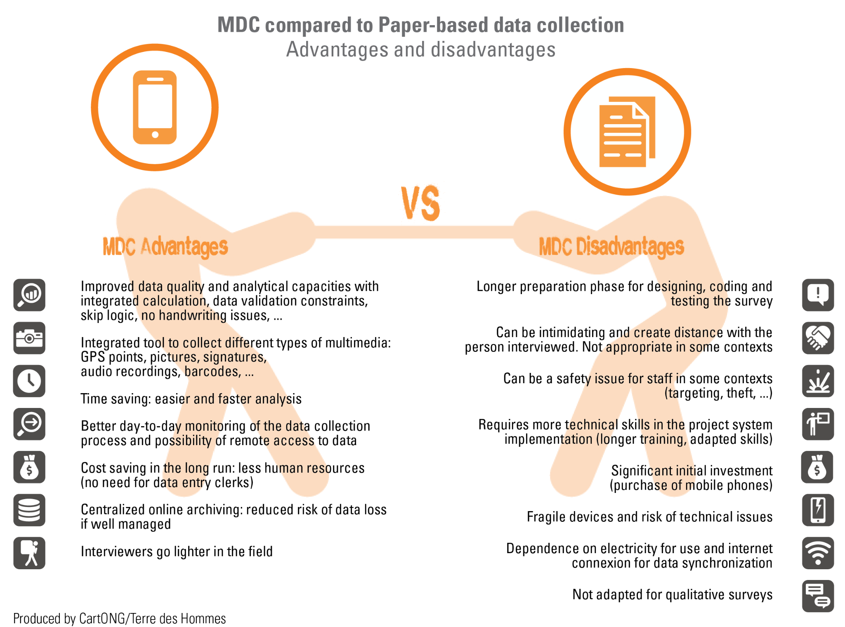
Comparison between mobile data collection (MDC) and PAPER BASE collection
Notes:
Exchange with participants to check ownership of information concerning data collection in module 3 - 5 minutes

Slide 14
QUESTIONNAIRE SUPPORT
Examples of digital media for mobile data collection
Koboo tool box: free for NGOs; easy, intuitive form design; question tree options. However, direct analysis on the platform is very limited (Koboo tool box is not an analysis tool). This requires data to be extracted into Excel for analysis; possibility of multi-language forms.
Google form: free; easy, intuitive form design; question tree structure remains linear (more difficult to condition a question to a specific answer / only to the previous answer); relatively complete answer analysis and excel extraction facility to complete the analysis if required; limited data protection.
Survey CTO: fee-based service; excel spreadsheet export is required for full data visualization; form design is possible on the platform; options for question tree structure; platform is in English.
To find out more: https://alnap.org/help-library/resources/benchmarking-de-solutions-de-collecte-de-donnees-sur-mobile-2021/
Notes:
Exchange with participants to check ownership of information concerning data collection in module 3 - 5 minutes

Slide 15
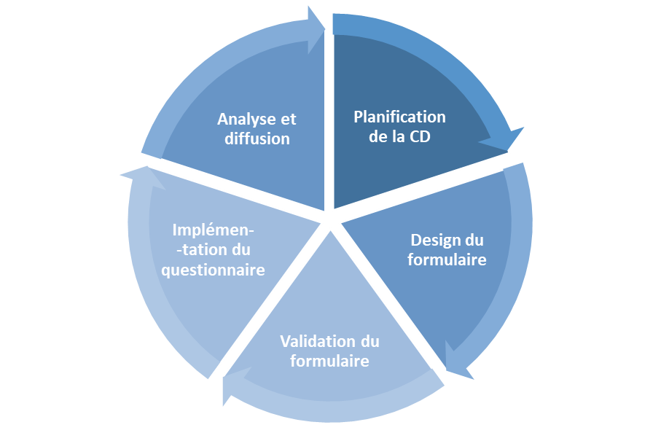

SURVEY - BEST PRACTICES
Survey feedback
Clean archiving
Form availability for other surveys
Feedback to respondents
Analysis plan/ Dashboard
What is the desired level of quality
Is data collection necessary?
What data collection methods are most appropriate (consider the safety context for staff and beneficiaries)?
Sampling
Data collection tool
Continuous quality control of survey submissions
Frequent debriefing with interviewers
Language control during surveys
Technical tips and tricks (metadata, constraints, etc.)
Language
Language
Questionnaire length
Consent
Technical validation of the form / Technical test (form of results...)
Consider testing understanding of key words and concepts and survey feasibility
Standardization test
Pilot site
Notes:
Exchange with participants to check ownership of information concerning data collection in module 3 - 5 minutes

Slide 16
DESIGNING A QUESTIONNAIRE
QUESTION/ANSWER?
Notes:
Exchange with participants on the questionnaire design session

Slide 17
II - DATA CONTROL

Slide 18
DATA CYCLE
source CartONG
Notes:
Situate the stage in the data cycle

Slide 19
DATA QUALITY: What to think about?
Validity
-Validity - Question(s) asked
-Reliability - Collection method(s)
-Accuracy - Sampling strategy
-Integrity - Data processing and management processes
-Temporality - Calendar + PlanningAccuracy
Temporality
Reliability
Integrity
Accuracy
Notes:
Validity - Data is valid when it accurately represents the variable/concept you intend to measure.
Reliability - Data is reliable when the collection methods used are stable and consistent. Reliable data are collected using tools such as questionnaires that can be implemented in the same way over and over again.
Accuracy - Data is accurate when there is little variation in the data. (Think of a "bull's eye"). Precision is very closely linked to sampling strategy.
Integrity - Data has integrity when it is accurate (complete and clean).
Timing - Data must be available when you need to use and share it. Data is of no use to you if it arrives too late to inform decision-making. This factor plays an important role in your data collection planning.

Slide 20

DATA CONTROL
In a monitoring-evaluation system, it is essential to check, control, clean and validate the data, whether in your database, your dashboard or the results of your questionnaires.
In a large database, select a representative number of rows and check the consistency of the answers/data entered.
Data entry errors can happen to anyone. Reviewing your data will enable you to detect errors. In Excel, signals can indicate these errors and enable you to rectify (clean up) the data.
Identify common errors and ask questions :
the wording of your question
the interviewer, who in the event of a repeated error may not have entered the question.

Slide 21
DATA CONTROL
In a monitoring-evaluation system, it is essential to check, control, clean and validate the data, whether in your database, your dashboard or the results of your questionnaires.
Who in your team has been identified as carrying out this data control and cleansing, and when?
Provide your teams with regular feedback on data quality, so as to improve the data collected and entered in a pedagogical way.
Data sharing and collective analysis time also help to check consistency, possible biases and data quality (difficulties encountered, etc.).

Slide 22
III - PROTECTION
MODULE 5

Slide 23

DATA PROTECTION - EXCHANGE TIME
?
What does the notion of data protection mean to you?
Have you already implemented data and respondent protection rules? If so, which ones?
Contact: @secours-catholique.org @secours-catholique.org
Notes:
Open an exchange and discussion on data protection and participants' knowledge and experience

Slide 24
ETHICAL CONSIDERATION OF DATA
-Informed consent
-Do no harm
-Confidentiality / Anonymity / Privacy
-Respect for the individual (respect for their time, experience, feelings - link with acceptance)
-Share results (provide "closing the loop" feedback)
-Physical protection (limit access, no unintentional sharing)
- Limit risks (collect only what will be used)
Notes:
Validity - Data is valid when it accurately represents the variable/concept you intend to measure.
Reliability - Data is reliable when the collection methods used are stable and consistent. Reliable data are collected using tools such as questionnaires that can be implemented in the same way over and over again.
Accuracy - Data is accurate when there is little variation in the data. (Think of a "bull's eye"). Precision is very closely linked to sampling strategy.
Integrity - Data has integrity when it is accurate (complete and clean).
Timing - Data must be available when you need to use and share it. Data is of no use to you if it arrives too late to inform decision-making. This factor plays an important role in your data collection planning.

Slide 25
DATA PROTECTION
Data protection must also be considered in terms of storage, accessibility and protection.
We need to ask ourselves, in light of the do no harm principle, but also national and international regulations (Europe: RGPD)
If you use a platform/cloud, is it protected?
Do you hold sensitive data?
Are they anonymized?
Where they are stored (paper or digital)
How long do we need to keep and store this data? Identify a time limit for data storage.

Slide 26
III - ANALYSIS AND USE

Slide 27
THE IMPLEMENTATION PHASE
START-UP
MONITORING & ASSESSMENT
MANAGEMENT
DATA COLLECTION
PROJECT DATABASE
BUDGETED OPERATIONAL PROJECT PLANNING MEETING AND PRESENTATION OF THE M&E
OPERATING PLAN OUTLINE
DATA ANALYSIS
BOARD LAYOUT
DATA CONTROL, VERIFICATION AND CLEANING
FINALIZING THE M&E PLAN
TRAME
M&E PLAN
USE OF ANALYZED DATA FOR PROJECT MANAGEMENT
DATA COMPILATION / DASHBOARD UPDATE
BOARD LAYOUT
DEFINITION OF ROLES AND RESPONSIBILITIES IN S&E (RACI)
PERIODIC FOLLOW-UP MEETING
STEERING (MONITORING PROGRESS OF ACTIVITIES, ACHIEVEMENT OF INDICATORS, TARGETS, ETC.)
RACI
M&E PLAN
USE OF DATA FOR REPORTING
REPORT FRAMES
DEFINITION OF COLLECTION TOOLS AND VERIFICATION SOURCES (SOV)
DECISION-MAKING (READJUSTMENT, UPDATING, ALLOCATION OF RESOURCES, ETC.)
QUARTERLY PROGRESS REPORT AND ANNUAL REPORT (Q4)
M&E CAPACITY-BUILDING PLAN (INTERNAL TEAM AND PARTNERS)
INFORMATION SHARING, PARTICIPATORY APPROACH WITH STAKEHOLDERS
EXTERNAL REPORTS (DONORS, NATIONAL AUTHORITIES, CONSULTATION FRAMEWORK, ETC.)
DASHBOARD SETTINGS
BOARD LAYOUT
ADVOCACY AND INFLUENCE, EXTERNAL COMMUNICATION
INTERIM EVALUATION (PROJECT LASTING AT LEAST 3 YEARS)
TRAME TdR EVALUATION
LAUNCH OF BASELINE STUDY
INFORMATION SHARING AND STAKEHOLDER FEEDBACK
ANNUAL PARTICIPATORY BALANCE SHEET
Notes:
Situate the training stage in relation to the SE diagram

Slide 28
DATA CYCLE
source CartONG
Notes:
Situate the stage in the data cycle

Slide 29
DATA ANALYSIS
Data analysis is the application of techniques applied to data to reveal useful information and support decision-making.
-After data collection, each individual data item can be assembled into a "dataset" and, using data analysis techniques, provide useful information.
The information uncovered by data analysis can then be used to facilitate decision-making.
Contact: @secours-catholique.org @secours-catholique.org

Slide 30
DATA ANALYSIS - How do I do it?
Tab 2. Summary and analysis allows you to identify and visualize certain cross-referenced data.
Further analysis may be required.
Data without analysis can mean anything and everything, so it's important to put them into dialogue. It's a question of putting certain information into perspective, cross-referencing it with qualitative information and arguing it to make it relevant and coherent.
The dialogue must be based on a participatory approach involving the various stakeholders.
Contact: @secours-catholique.org @secours-catholique.org

Slide 31
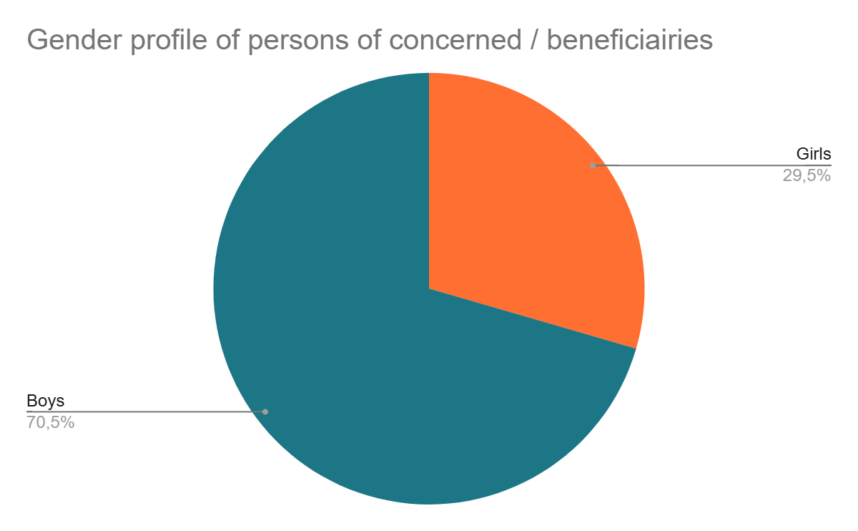
DATA ANALYSIS - Example
Follow-up of beneficiaries/people reached
A mis parcours de votre projet, voici les données concernant le profil genre des enfants touchées par le projet. What do you observe? How do you analyze and interpret this information? What kind of decisions need to be made for the project's future?
Notes:
Ask participants what they see, how they analyze this information (many boys than girls), how to interpret it, argue it, what kind of decisions will have to be made?

Slide 32

EXERCISE - CASE STUDIES
Two working groups
On tab 2 of the case study dashboard, analyze the various items of information.
Fill the "narrative indications" boxes with information, possible explanations, questions and possible decisions.
Propose a project status report based on the information reviewed and analyzed.
You may also identify issues related to the dashboard format: for example, what information would have been useful to include or visualize.
Present your findings in plenary (5 minutes per group)
You have 15 minutes.
Notes:
A case study is available, and it is possible to form two groups. At the end of the group discussions, a debriefing session should be planned—each group will be required to deliver an oral presentation summarizing their case study project.Filling out the boxes is simply a support tool—by definition, it is fictional, so participants should project themselves into possible explanations or analyses. For this reason, they may, for example, formulate questions or define what should be discussed with teams or stakeholders in order to gather more information. The case study does not reflect all the information of a real project—it is therefore not about checking whether the information is accurate or consistent, but rather using it as a training tool. The budget tab is not included in the case study.

Slide 33
USES - EXCHANGE TIME
?
How do you think you can use the information you've gathered in the ES (illustrated in the dashboard)?
As a project manager, how can this information help you manage your project?
What are you going to do with this information?
Contact: @secours-catholique.org @secours-catholique.org
Notes:
Following the case study dashboard data analysis exercise, open a discussion with participants on the possible uses of this information: what decisions can be made? what use can it be for the project manager, but also in terms of communication with stakeholders....

Slide 34
USES
Use of analyzed data for project management
Use action plan management and progress monitoring information. What decisions should be taken for activities that are significantly behind schedule?
Make decisions regarding budget consumption
Check the relevance of indicators
Redirect activities if necessary
Steering (monitoring progress of activities, achievement of indicators, targets, etc.)
Decision-making (readjustment, updating, allocation of resources, etc.)
Communicate information to partners and share information (explain delays, progress, results, etc.).
Ensure accountability to partners and transparency
Contribute to horizontal and collective management
Information sharing, participatory approach with stakeholders
Annual participatory review
Use data to inform, influence and advocate: your data and statistics on the people affected/concerned (school enrolment rates, results achieved...).
Advocacy and influence, external communication
Notes:
Summarize the previous discussions by presenting the various uses - also recall that the data are used to facilitate the production of reports

Slide 35
III - INFORMATION PATH

Slide 36

DATA AND INFORMATION PATH
The point of a monitoring-evaluation system and data management is to circulate information.
It is therefore essential to clearly define the data and information flow in the M&E plan (document word).
Contact: @secours-catholique.org @secours-catholique.org
Who takes part in the analysis?
Who holds the information?
Who does he give it to?
Who records the data (DB/Dashboard)?
Who takes part in the analysis?
Who do we send information to?
Who do we give information back to?
This step is often overlooked, yet it is essential to the principle of accountability.

Slide 37
DATA AND INFORMATION PATH
Example - Dashboard
When?
Monthly - no later than the XXth of each month
Monthly - no later than the XXth of each month
Quarterly - no later than the XXth of each quarter
Monthly - no later than the XXth of each month
Quarterly - no later than the XXth of each quarter
Quarterly - no later than the XXth of each quarter
Dashboard update: tab 3 (action plan), tab 4 (indicator tracking)
Dialogue and data analysis - monthly project follow-up meeting.
Complete the "analysis" boxes in Tab 2 (balance sheet and analysis)
Dialogue/reconciliation tab 5, budget monitoring, and accounting data, complete comments column
Sharing the dashboard - Country Direction
Sharing the dashboard (in addition to the quarterly report) with Director of Programs and Technical Resources
Sharing feedback, comments, questions, analysis, needs, from international management to the project team
What?
Who?
Project manager (in collaboration with MEAL manager?)
Project team members, support teams and operational partners involved, regional team (optional participants /Project
The project manager and administrative manager
from : Project managers
to : Country Director
cc: Administrative manager, logistics manager? partners?xxxx
from : Country Director
to : Regional Programs Coordinator
cc: Regional Finance and Support Services Coordinator
from : Regional Programs Coordinator
to : Project Manager
cc: Country Director
Notes:
Show the example of the dashboard path

Slide 38
DATA AND INFORMATION PATH
Example - Dashboard
When?
Quarterly - no later than XX
Quarterly - no later than XX
Quarterly - no later than XX
Quarterly - no later than XX
Complete quarterly progress report (cumulative report T1/T2/T3/T4)
Review and compilation of quarterly progress reports
Review of quarterly report by regional programs coordinator
Sharing feedback, comments, questions, analysis, needs, from international management to the project team
What?
The project manager
CD
The regional programs coordinator
The regional programs coordinator
Who?
from : Project managers
to : CD
cc :
from : CD
to : Regional Programs Coordinator and Director Programs and Technical Resources
cc :
from : Regional Programs Coordinator
to : Project Manager
cc: Country Director + XXXXXX

Slide 39

EXERCISE
INDIVIDUALLY
In the M&E plan (word document), section 4.2 information management; diagram the data and information path of your own project, specifying the stakeholders involved.
You have 10 mins.
Notes:
Optional - depending on the time available - Suggest that one or two participants present their own diagrams.

Slide 40

TO REMEMBER
KEY MESSAGES
Data collection :
Design your questionnaire to suit your audience. Limit questions to essential information.
An important data quality control and cleaning step to ensure the reliability of the analysis.
The guiding principle is to do no harm when collecting and using data
Data collection :
All data must be analyzed to become relevant, usable and shareable information.
A collective and participative analysis
Using data to enhance project management efficiency and accountability.
Notes:
Data collection and data analysis

Slide 41

Next module
Transition and closing phase :
M&E process and milestones for project closure
How to prepare a final evaluation
End of training :
Reviews

Slide 42

INSTRUCTIONS INDIVIDUAL WORK

Slide 43

INDIVIDUAL WORK
Continue work on setting dashboard parameters, in particular tab 2 - balance sheet and analysis
Initiate data entry in tab 3 (action plan) and tab 4.2 (indicator tracking).
View the first possible analyses
Notes:
Note the good practices mentioned by participants

Slide 44
END OF SESSION 5
THANK YOU!

