Slide 1

Monitoring & EVALUATION
experiential
Training

Slide 2
project closing
MODULE 6

Slide 3
AGENDA
I - Learning review Module 5
II- Closing the project
III. Evaluating your project
IV. Learning concepts and capitalization
Notes:
Check session 3 - dashboard presentation - to be updated

Slide 4
PEDAGOGICAL OBJECTIVES - Session 6
At the end of this module, participants should be able to :
Identify processes and products for the closing phase
Identify the steps involved in carrying out an assessment
List the criteria needed to define the evaluation questions.
Understand the concepts of learning and capitalization.
Notes:
Exchange with participants to check dashboard objectives - 5 minutes

Slide 5
I - Learning review MODULE 5

Slide 6
Experience feedback
QUESTION/ANSWER?
How did you :
-set the dashboard parameters, in particular tab 2
-Filling data in tab 3
Have you encountered any particular difficulties?
Notes:
Questions and answers about the individual work carried out: The work instructions were :
Continue work on setting dashboard parameters, in particular tab 2 - balance sheet and analysis
Initiate data entry in tab 3 (action plan) and tab 4.2 (indicator tracking).
View the first possible analyses

Slide 7
II. project closure
MODULE 6

Slide 8
Different end-of-project scenarios
What are the different possible scenarios at the end of the project?
04
02
01
03
05
Notes:
Exchange with participants on the different ways of closing a project that they have already experienced, or that are possible, and the difficulties and lessons learned encountered. Attempt to identify 5 different ways of closing a project. 10 min.

Slide 9
DIFFERENT SCENARIOS
01
The project is officially over and all project closure activities have been completed
Closure
02
Transfer
The continuation of the project product or service is entrusted to a local partner (local NGO, international NGO)
03
Negotiation of additional time to complete the project (may be at additional cost or ‘no’ cost)
Extension
04
Expansion
Identification of elements to be replicated in a new area or target population
05
Continuation through a new phase with modified interventions or activities
Redesign
Notes:
Closure: The project is officially over and all project closure activities have been completed.
Transfer: The continuation of the project product or service is entrusted to a local partner (local NGO, international NGO community, government entity, etc.).
Extension: Negotiation of additional time to complete the project (may be at additional cost or ‘no’ cost);
Expansion: Identification of elements to be replicated in a new area or target population
Redesign: Continuation through a new phase with modified interventions or activities

Slide 10

Sustainability principle
A project must be sustainable
Main question is : What will remain after our intervention?
By definition, a project has a beginning and an end.
This closure must be anticipated to aim for a form of sustainability
Unfortunately, fencing is all too often underfunded
Sometimes even outside the cost eligibility period
Sustainability plans are prepared when the project is set up.

Slide 11

Sustainability checklist (project Closure)
Resources?
Capacity?
Risks and responses?
A stakeholder?
Processes and networks?
Motivation?
Are the necessary human resources available to pursue the product or service? Do you need specific human resources?
Does the organization or institution taking over have the technical/financial capacity to do so?
Are there any risks involved in "transferring" your project?
Have the relevant stakeholders been mobilized/informed?
Does sustainability require collaboration or coordination between different players?
Have the beneficiaries, the community and other stakeholders taken ownership of the project? Are they keen to keep it going?

Slide 12


PRODUCTS/PRODUCTION PROJECT CLOSING
In groups
In 4 groups, try to identify the different products/outcome that may be needed for a project closing.
let yourself be guided by the diagram FOLLOWING
You have 10 mins.

Slide 13
What are the key closing products?
  Final narrative reports
  ?
  ?
  Contract closure (suppliers, subcontractors)
  ?
  ?
  ?
Preparing reports
Administrative closure
Evaluation
Lessons learned
  ToR eval
  ?
  ?
  ?
  ?
  ?

Slide 14
Key closing products
  Final narrative reports
  Financial reports
  Other (endline, etc)
  Contract closure (suppliers, subcontractors)
  Financial closing (receipt of funds, paid invoices, etc.)
  Reassigned project staff?
  Equipment sold, transferred?
    Archiving
Preparing reports
Administrative closure
Evaluation
Lessons learned
  ToR eval
  Conducting the assessment
  Distribution of results
  Kick off meeting
  Documenting lessons learned
Notes:
Check with participants to see if there are additional tools within ACTEI or other experiences to add.

Slide 15
Why anticipate the closing phase of a project?
The various end-of-project scenarios allow to:
Prepare for closing: organize in advance all the steps needed to finalize the project in the best possible conditions.
Ensure a smooth transition: plan the transfer of responsibilities, knowledge and results to stakeholders or beneficiaries.
Mobilize dedicated resources: plan and allocate the human, financial and material resources needed for the closing on time.
Communicate clearly with stakeholders: informing and involving all partners, beneficiaries and donors about the modalities and consequences of the end of the project.

Slide 16
III - EVALUATING YOUR PROJECT
MODULE 6

Slide 17
WHAT ARE MY ASSESSMENT NEEDS?
AUDIT
EVALUATION
MONITORING
Which assessment for which needs?
Notes:
Introductory slide only to announce what the next slides will cover

Slide 18
Audit / Evaluation / MONITORING ?
INDIVIDUALLY
Identify the right answer. Is the information obtained through audit, monitoring and/or evaluation?
REPLY IN THE CHAT to each slide
Notes:
Exercice can be done by quizz or on the chat box

Slide 19
QUIZZ: EVALUATION, FOLLOW-UP OR AUDIT
!
IE give my AN opinion ON THE PURPOSES OF THE PROJECT ....
AUDIT
EVALUATION
MONITORING
Notes:
EVALUATION - quiz or chat

Slide 20
QUIZZ: EVALUATION, FOLLOW-UP OR AUDIT
!
IT collectS data to help TO FOLLOW UP the project...
AUDIT
EVALUATION
MONITORING
Notes:
MONITORING

Slide 21
QUIZZ: EVALUATION, FOLLOW-UP OR AUDIT
!
IT guaranteeS compliance with standards and put an end to non-compliant practices...
AUDIT
EVALUATION
MONITORING
Notes:
AUDIT

Slide 22
QUIZZ: EVALUATION, FOLLOW-UP OR AUDIT
!
IT can be DONE AT mid-way, at the end or after the project has been completed.
AUDIT
EVALUATION
MONITORING
Notes:
EVALUATION
(Possibly AUDIT - annual and/or end of project)

Slide 23
QUIZZ: EVALUATION, FOLLOW-UP OR AUDIT
!
IT regularly and continuously realized.....
AUDIT
EVALUATION
MONITORING
Notes:
Monitoring

Slide 24
QUIZZ: EVALUATION, FOLLOW-UP OR AUDIT
!
IT produced by the project team...
AUDIT
EVALUATION
MONITORING
Notes:
MONITORING and INTERNAL MID-TERM EVALUATION

Slide 25
QUIZZ: EVALUATION, FOLLOW-UP OR AUDIT
!
IT would be useful to the project manager....
AUDIT
EVALUATION
FOLLOW-UP
MONITORING
Notes:
ALL

Slide 26
QUIZZ: EVALUATION, FOLLOW-UP OR AUDIT
!
IT WOULD be SHARED with all stakeholders.
AUDIT
EVALUATION
MONITORING
Notes:
EVALUATION
(monitoring feeds into evaluation conclusions, but analyses of data collected during monitoring can also be shared)

Slide 27
Difference between EVALUATION, MONITORING and AUDIT
 | EVALUATION | MONITORING | AUDIT
Description | The assessment is : One photo. Diagnosis. An appreciation. A help to decision-making. | The follow-up is : An approach. A fully-equipped System. Continuous measurement. A daily management tool. | The audit is : A control procedure with internal standards. A mission to control the execution of an action at a given time.
Frequency | Episodic, mid-term, end-of-project or post-project | Periodic, continuous, regular frequency. | Episodic: Annual / final.
Main action | Assessment, measurement of effects, attribution of causality. Evaluates performance | Recording, supervision, comparison with schedule. Analyzes project progress | Checking compliance with internal standards.
Objectives | Improve the external effectiveness, effects and impact of future programming (learning). Supporting accountability and transparency | Improve internal efficiency, modify business plans or resource allocation. Identify fit with project objectives and targets | Ensure compliance with standards, put an end to non-compliant practices.
Information sources | Monitoring information, studies, surveys, analyses, interviews. | Information provided regularly by the management system. | Management follow-up information.
Contractors | Authorities who decided to implement the project. | Project manager, responsible for project management. | Authorities of the organization or its guardianship.
Produced by | Evaluators from outside the project (internal or external to the organization), with self-evaluation in some cases. | The team responsible for implementing the project. | Specialized, accredited auditors (internal or external).
Main recipients | Authority having decided to carry out the project. | Project manager, implementation team. | Organization or supervisory authorities

Slide 28
EVALUATION: PHASES AND STAGES
EVALUATION
M&E GUIDE
EVALUATION
FINAL INTERNAL OR EXTERNAL EVALUATION
DEFINING EVALUATION QUESTIONS AND FORMULATING TORS
TRAME TdR EVALUATION
PROJECT CLOSING PHASE
AO CONSULTANTS FOR EXTERNAL EVALUATIONS
INTERNAL AO PROCESSES
CONDUCTING THE EVALUATION . DATA COLLECTION
FINAL EVALUATION REPORT
EXTERNAL REPORT FRAMES
FEEDBACK TO ALL STAKEHOLDERS

Slide 29
EVALUATION OBJECTIVES
Learning
What worked?
What didn't work so well?
Project strengths / weaknesses?
Accountability
Does the project meet needs?
What are the results?

Slide 30




EVALUATION WHY?
Examination, research or analysis to determine the value or significance of the action
Objective,
step back from the immediacy of action and reflect on it, basing results on credible evidence
Learning from experience
To improve policy and practice, but also to increase accountability, is the very purpose of an evaluation.
Systematic, planned and consistent approach based on credible methods

Slide 31
TYPES AND METHODS OF EVALUATION
INITIAL ASSESSMENT
MID-TERM EVALUATION
END-OF-PROJECT EVALUATION
EX-POST EVALUATION
INTERNAL ASSESSMENT
EXTERNAL EVALUATION
MIXED EVALUATION (INTERNAL AND EXTERNAL)
SELF-EVALUATION
PARTICIPATORY EVALUATION
OR JOINT
Notes:
They are the different Types and the different Methods for the type of the evaluating. The reading of the slide is not linear
Clarification: Ex-post evaluation is an evaluative assessment carried out after policy actions have been completed, in order to demonstrate the achievement of policy objectives, policy impacts and results to stakeholders and the general public.

Slide 32
ASSESSMENT STAGES
Don't forget to plan for evaluation right from the diagnosis and project design phases!

Slide 33
EVALUATION STAGES
In a 3/4 groupS
Your program manager asks you to prepare an evaluation of your project.
How do you go about it?
Put the 10 evaluation steps in order
let yourself be guided by the NEXT SLIDE
You have 10 mins.

Slide 34
EVALUATION STAGES
Write the ToR
Follow up on recommendations
Schedule (Initiate) assessment
Write the evaluation report
Gather and analyze data
Allocate a budget
Define objectives and framework
Prepare the assessment with teams
Report and disseminate results
Select the evaluation team
Notes:
10 fundamental steps for team ownership of evaluation
The table shows that the evaluation process is not limited to the time spent in the field by the evaluation team, but involves a great deal of work upstream and downstream of the evaluation, and that this work mainly concerns the project team.
Don't make a restitution, just present the following slide

Slide 35
EVALUATION STAGES - Role & Responsibilities
STEPS |  | RESPONSIBILITIES
 |  | CONTRACTORS | EVALUATORS
1 | Schedule initial assessment | x
2 | Define objectives and framework | x
3 | Write the ToR | x
4 | Allocate a budget | x
5 | Select the evaluation team | x
6 | Prepare the assessment with teams | x
7 | Gather and analyze data |  | x
8 | Write the evaluation report |  | x
9 | Report and disseminate results | x | x
10 | Follow up on recommendations | x
The project team is highly mobilized, before, during and after the field phase of the evaluation!

Slide 36

Step 1: Schedule (initiate) the assessment
Defining the moment of the evaluation in the project
Mobilization of a steering committee

Slide 37

Step 2: Define objectives and framework
Why are we doing this assessment?
What are the expectations for the project? For the organization?
What will its scope be?
Often based on a multi-stakeholder consultation phase

Slide 38

Stage 3: Writing Terms of Reference (TOR)
The ToR includes:
Project/program context and description (objectives, expected results, activities, timetable)
Assessment objectives
Evaluation criteria
Evaluation budget
The proposed timetable
Evaluator profile
The ToR must be shared with the project team = Ownership issues

Slide 39

Step 4: ALLOCATE A BUDGET
A global budget is provided for when the project is set up.
The budget will essentially concern the field phase, but it is important not to forget the costs associated with mobilizing/participating stakeholders upstream and disseminating the evaluation downstream.

Slide 40
THE COSTS OF AN EVALUATION
In a 3 / 4 groupS
In Module 2, the various cost items to consider when budgeting for an appraisal were presented.
In groups, try to find the 9 expense items
You have 5 mins.

Slide 41
Cost factors to consider
Travel
Staff
Consultants
Support staff
Visas, flights for evaluation team and accompanying staff, flights for meetings, internal travel for team and accompanying staff
Staff salaries and allowances, partner staff allowances and other staff.
Team leaders, international consultants, national consultants, other consultants
Remuneration and allowances for administrative staff, researchers, interpreters, drivers, security personnel, etc.
Other
Daily benefits
Report production
Communication, e-mail and post, teleconferences, licenses and legal fees, security.
Data entry
Meetings and workshops
Rental, meals and allowances.
Accommodation and per diem for consultants
Data entry and cleaning to remove answers that don't make sense, such as someone recorded as both male and pregnant.
Rental, meals and allowances.
Notes:
ALNAP interactive - p.89/Table 8 (https://www.alnap.org/system/files/content/resource/files/main/eha-pilot-alnap-2013-fr.pdf)

Slide 42

Step 5: Select the evaluation team
Process of call for tenders
Launching call for tenders
Receiving of applications
Sorting and going back and forth with candidates
Final selection
Don't underestimate the time needed for this step

Slide 43

Step 6: Prepare the evaluation with the project team (field)
Informing the field team and stakeholders
Organize the documents to be submitted to the evaluation team
Plan important appointments (contacts and/or introductions to certain stakeholders)

Slide 44
Step 7: Collect data
Ensure that the necessary documents are available (organization of resources)
Role of the evaluation team
Document review: analysis of reports, project documents, strategic documents (and external document review)
Quantitative methods: questionnaires/surveys
Qualitative methods: interviews/focus groups/observation

Slide 45
Step 8: Write the evaluation report
Role of the evaluation team
The report must follow the guidelines of the ToR:
Maximum number of pages
Executive summary
A reminder of the ToR
A presentation of the methodology - Limits of the evaluation
Background information
The main results
Analysis of the most significant results
Recommendations
Annexes (contacts, reference documents, agenda, etc.).

Slide 46
Step 9: Reporting and disseminating results
The evaluation team presents the results
Discussion between evaluation team and project team on a draft report
Additions and clarifications of certain elements
Finalizing the report
The project team must ensure that the results are disseminated to those concerned (learning and accountability).

Slide 47

Step 10: Implementing the recommendations
The project team must monitor implementation of the recommendations
An evaluation with no follow-up recommendations or action plan is a waste of time and money.

Slide 48
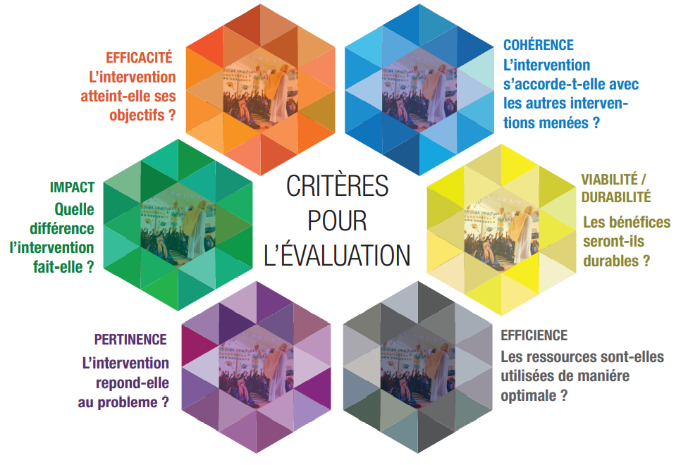
Evaluation criteria
Consistency: Is the intervention consistent with other interventions?
Effectiveness: Is the intervention achieving its objectives?
EVALUATION CRITERIA
Impact: What difference does the intervention make?
Viability/sustainability: Will the benefits be long-lasting?
Relevance: Does the intervention address the problem?
Efficiency: Are resources being used optimally?
Notes:
Effectiveness: Is the intervention achieving its objectives?
Impact: What difference does the intervention make?
Relevance: Does the intervention address the problem?
Efficiency: Are resources being used optimally?
Viability/sustainability: Will the benefits be long-lasting?
Consistency: Is the intervention consistent with other interventions?

Slide 49
evaluation questions & criteria
In 3 / 4 groups
Each group will define two evaluation questions on one of the following evaluation criteria: Relevance, Effectiveness, Efficiency.
Take inspiration from one of your projects and formulate two evaluation questions according to the criteria your group has identified. These are the questions you would like answered in a final evaluation of your project.
You have 10 mins.

Slide 50
RELEVANCE
The aim is to assess whether the action and its objectives are in line with the problems identified and the real needs.
Examples :
Does the tutoring offered to primary school pupils address the major causes of school failure identified locally?
Is the construction of school infrastructures the best response to the difficulties of access to education in this area?

Slide 51
EFFECTIVENESS
This involves comparing the results obtained with the initial objectives, hence the need to have clearly identified objectives right from the project design stage.
Examples:
Has the project led to an increase in the school enrolment rate for children in the target areas, as planned?
Have teacher training sessions improved the quality of classroom teaching practices?

Slide 52
EFFICIENCY
This involves comparing the results obtained with the activities and resources implemented. It is an assessment of the results obtained in relation to the resources mobilized. (Financial and human resources)
  Examples:
  Have the human resources mobilized (facilitators, teacher trainers, etc.) been sufficient and well used in relation to the results achieved?
  Could some of the project's activities have been implemented at lower cost or with greater pooling of local resources?

Slide 53
CONSISTENCY
The aim is to assess the intervention logic and the well founded of the relationship between resources and activities, on the one hand, and expected results and the specific objective, on the other.
Examples:
Is the project in line with national and local education policy priorities?
Does the project complement or duplicate other educational initiatives in the intervention area?

Slide 54
VIABILITY / SUSTAINABILITY
This involves analyzing the chances of the action continuing once external aid has ceased. This is an important criteria to take into account when identifying the activities to be implemented. It is of particular interest to project contractors.
Examples:
Are local structures (schools, management committees, education authorities) able to continue the activities initiated by the project?
Does the project include a transition or relay strategy towards public or community partners?

Slide 55
IMPACT
This involves assessing the effects and changes of the project on its environment (technical, economic, social, political, etc.). It involves analyzing all the positive and negative effects, both foreseen and unforeseen, resulting from the project.
Examples:
Has the project contributed to a sustainable improvement in access to education for the most marginalized children (girls, disabled children, children from rural areas, etc.)?
Can we observe a positive long-term effect on the academic success or educational level of the children we support?

Slide 56
EVALUATION TIPS
Plan evaluation well in advance
Giving the exercise a participatory dimension
Equip the project with a good monitoring system
Giving yourself time for feedback
Debate conclusions internally and appropriate recommendations

Slide 57
INFORMATION PATH
At the latest xxx before the end of the project or before the mid-term of the project (for projects lasting more than 3 years)
No later than xx months before the end of the project
At the latest xxx before the end of the project or before the mid-term of the project
At the latest xxx before the end of the project or before the mid-term of the project
No later than xx weeks after xx
No later than xxx after receipt of evaluation report
When?
Draft Terms of Reference - Discuss and prioritize evaluation questions - what would you like to know that you have not been able to observe/analyze in the dashboard data?
For external evaluations: launch of call for tenders and selection of consultant(s)
Conducting external or internal evaluations
Report validation
Sharing and reporting the results of the assessment and encouraging dialogue with all stakeholders and persons concerned (feedback workshop and dispatch of report).
Validation of the ToR
What?
Project manager with team members
Director of Programs and Technical Resources,
Based on 2 criteria:
- Budget over 300 thousand euros
If multi-country
Country Direction
Consultants, CD, country team
From: Director of Programs and Technical Resources
To: CD
The project manager
Who?
from : Project managers
to : Country Director, M&E officer
from : Project managers
to : Country Director, Project Team, Partners cc: Regional Programs Coordinator; Director of Programs and Technical Resources

Slide 58
III - Learning and capitalization
MODULE 6

Slide 59
Definitions
Individually
In the chat room, each person will give a definition of what learning is and what capitalization is. A definition in their own words, as if they were explaining it to someone outside the world of cooperation.
You have 5 mins.

Slide 60
LEARNING
Learning is a systematic process aimed at identifying, formalizing, disseminating and effectively using the knowledge gained from a particular project or program experience.

Slide 61
LEARNING
Learning-oriented assessments are designed to facilitate individual, group and/or organizational learning:
They are excellent opportunities for case-based learning, and can be very effective in analyzing what worked and what didn't, and how performance can be improved (both individually and collectively). They can take place at any point in the program cycle.
Evaluations can be very useful for creating knowledge and launching organizational learning processes.

Slide 62
CAPITALIZATION
Capitalization means giving oneself the means to transform knowledge into shareable knowledge. Unlike evaluation, capitalization does not pass judgment.

Slide 63
CAPITALIZATION
  Capitalization is the ability to:
Identify
Formalize
Organizing knowledge and know-how
Formulate in a way that others can use
  A learning tool by definition

Slide 64
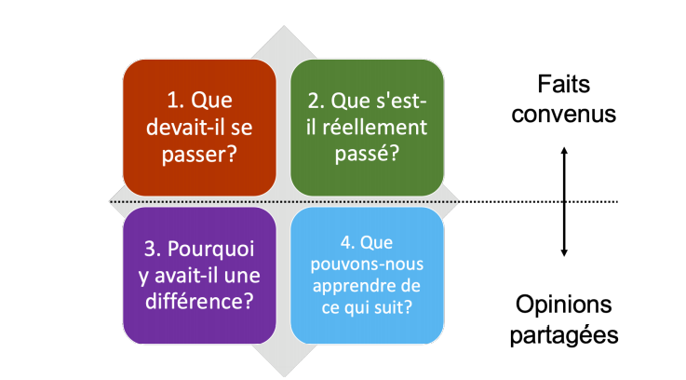
LEARNING AND CAPITALIZATION TOOLS
Activity form
Closing meeting
Intermediate or final assessment
Learning meetings
After-action review
Agreed facts
1.What was supposed to happen?
2.What actually happened?
After action review .....
3. Why was there a difference?
4. What can we learn from the next
Divided opinions
Notes:
What was supposed to happen?
What actually happened?
Why was there a difference?
What can we learn from the following?
Agreed facts
Divided opinions

Slide 65
M&E LEARNING: Process not set in stone
  The M&E system experiments, tests and improves itself, and teaches us as much as we teach it.
The M&E system is a continuous learning tool:
It helps to identify what is useful and what is not.
It highlights missing or poorly tracked data.
It helps identify what works... and what needs to be adjusted
  Improving your device is already learning.
Every use of M&E is an opportunity for evolution

Slide 66

TO REMEMBER
KEY MESSAGES
The closing of a project must be prepared from the conception.
It must be planned and budgeted for, and include a focus on sustainability.
There are several end-of-project scenarios.
Closure, transfer, extension, expansion, reorganization: anticipate these depending on the context.
Sustainability is built with local actors.
Mobilization, capacity building, ownership and coordination are essential.
Evaluation is a tool for learning and accountability.
It helps us understand what worked and what didn't, and why.
10 steps to a successful evaluation.
From planning to implementing recommendations.
Evaluation criteria guide the formulation of the right questions.
Relevance, effectiveness, efficiency, coherence, sustainability, impact.
The aim of an evaluation is to learn and capitalize on
They help improve practices and share knowledge.

Slide 67

FURTHER EXPERIMENTATION
Use M&E tools to identify :
what is useful and what is not
what's missing
what works and what doesn't
Reminder:
These aren't the final versions, so there's no need to perfect them, just to learn and improve the tools so that they can be applied to all projects.
We have the right to make mistakes, and collective learning comes out of them.

Slide 68

CLOSING SESSION 6
WHAT WORKS
WHAT NEEDS TO CHANGE
THEME TO BE CLARIFIED?

Slide 69
What Next in MEAL
Phases pLANNED
MEAL TRAINING
PILOT PHASE
FULL FLEDGED IMPLEMENTATION
Notes:
ALL

Slide 70
END OF SESSION 6
THANK YOU!

